Slide 1

Certification Scheme for UAS –
Strengthening the Quality Infrastructure in Agri Drone Space – 02 May 2022
Dr. Manish Pande,
Director and Head, PAD Division, QCI
QUALITY
COUNCIL
OF INDIA

Slide 2

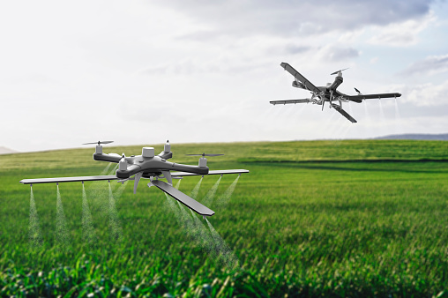
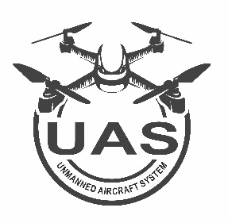
QCI – Shaping India’s drone economy
Talking points
Brief Overview
Who we are
Established by Govt. of India and Indian Industry, QCI is a functionally autonomous and financially independent body.
The drone rules promulgated by Ministry of Civil Aviation, GoI facilitated easier access through simplified rules in the sunrise Indian drone economy align with the vision of Hon'ble Prime Minister to establish India as a drone hub by 2030.
Drone Rules - 2021
In accordance to Drone Rules, 2021, QCI upgraded it’s scheme from RPAS to CSUAS to align with the Drone Rule 2021
CSUAS Scheme

Slide 3
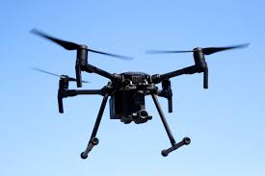










Design and Implementation of Voluntary Schemes
UAS
Scheme
Approved/Accredited Certification Bodies
Scheme Owner(s)
(QCI)
Stakeholder Consultation: MSC – SC, TC, CC
Standards
Demonstrating Compliance
Directorate General
of Civil Aviation
Type Certificate
Manufacturer submits D1 to ATE (CABs)

Slide 4
Issuance of Type Certificate (TC) – CSUAS
The Certification Body (CB) as selected by the D1 Form applicant receives the requisite Form and responds with necessary comments within 7 days.
DGCA based on the SoC issues Type certificates within 15 days of receiving SoC.
Phase-2
Phase-4
Phase-1
Phase-3
QCI Provisionally Approved and Accredits ATEs/CBs as per UAS Scheme
D1 Form are submitted on the digital sky portal.
CB is mandated to submit a “Statement of Conformity” to the DGCA within 60 days of receiving D1 Form.

Slide 5
Strategic Challenges – Resource intensive supply chain and technical issues
Strategic Challenges
Critical shortage of accredited testing labs
Low number of qualified CBs/ ATEs
Time intensive battery testing
Low penetration of sensitisation initiatives
Slow rate of acceptance amongst manufacturers

Slide 6
Easing hurdles, boosting CBs and the way forward
Into the future
Discovering new avenues of impact with extensive and diverse stakeholder engagement, assessing market frameworks and feasibility.
The scheme aims to incorporate policy measures regarding BVLOS, day-night operation, autonomous UAS etc.
More CBs ensuring compliance
Currently standing at 3,
6 more CBs including
  4 from FMTTI Haryana, M.P, Assam and Andhra Pradesh
  An accredited lab to be processed for CB
Drones in agriculture
Exploring the avenues of interest and involvement to sustain and promote the drone economy in agriculture.
Reaching out to manufacturers
We’re here to hear. QCI has extensively reached out to all stakeholders involved to incorporate their feedback and assess viable solutions through qualified inputs.
Building Blocks
Developing capacity and awareness through sensitizing all interested value components in the supply chain of 1000 participants
Sensitization sessions conducted with FMTTI management and staff to make them aware of scheme requirements

Slide 7
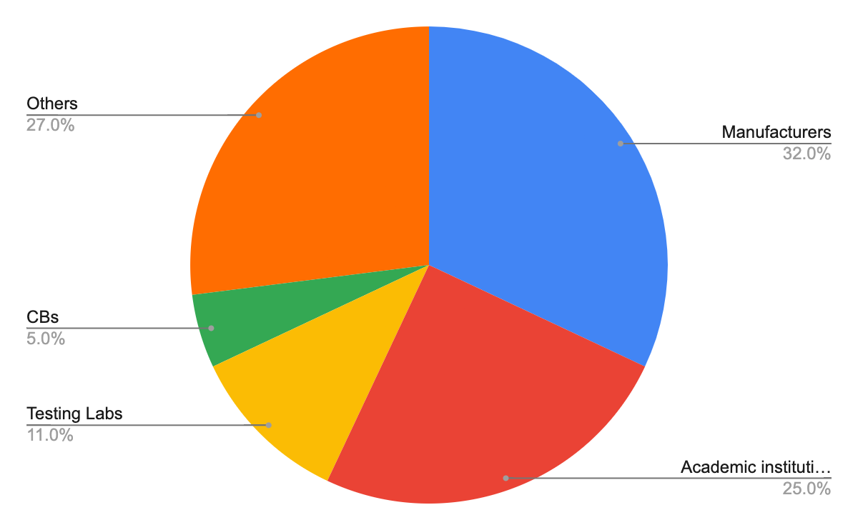
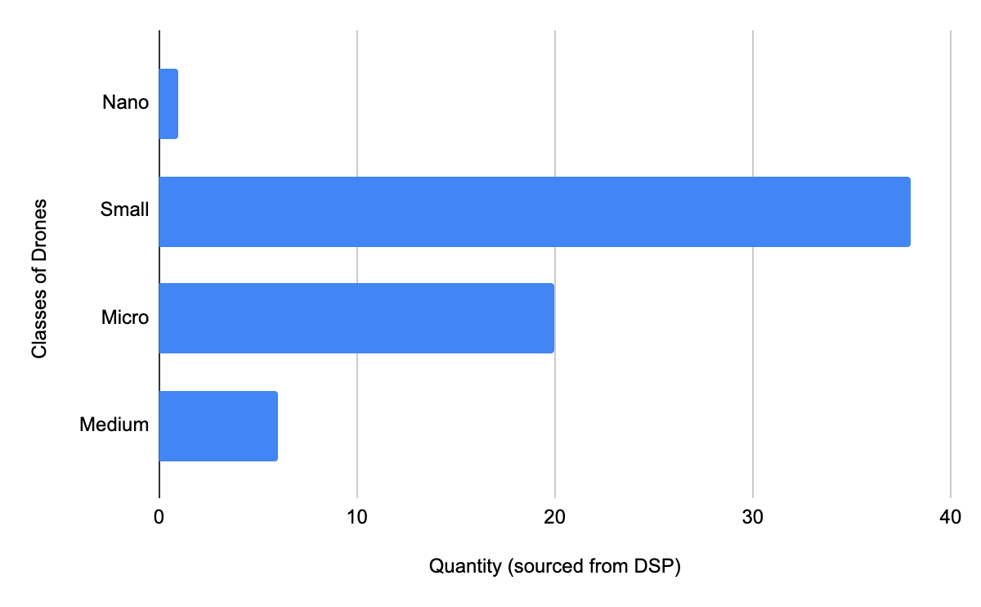
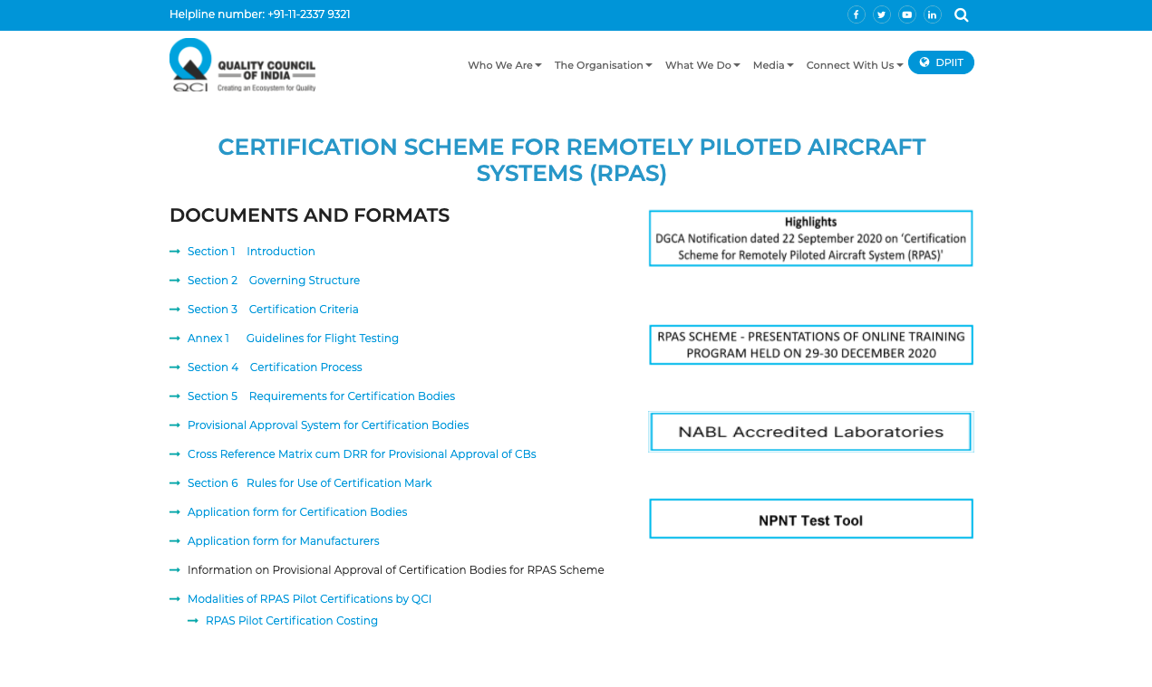
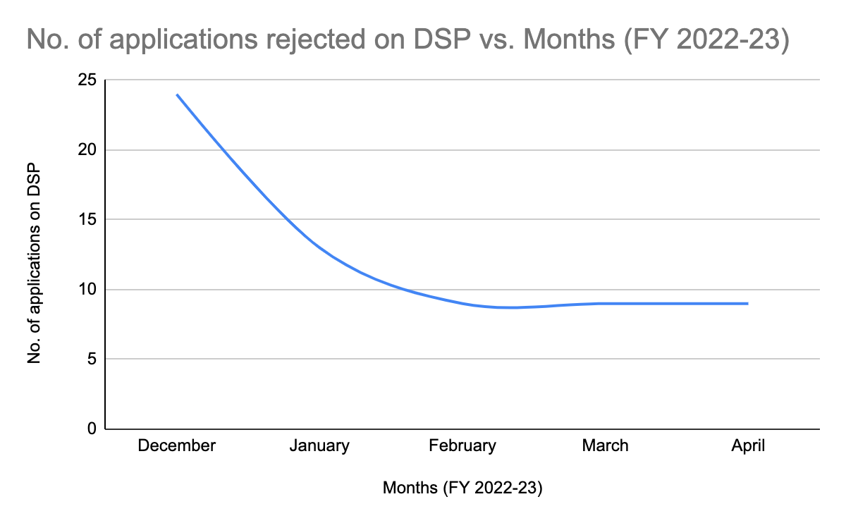
D-1 Form: Category wise
Stakeholder spread
Decline in rejection of D-1 Forms by CB
UAS Scheme Portal

Slide 8
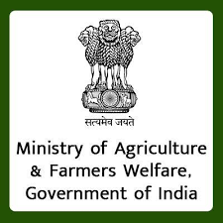

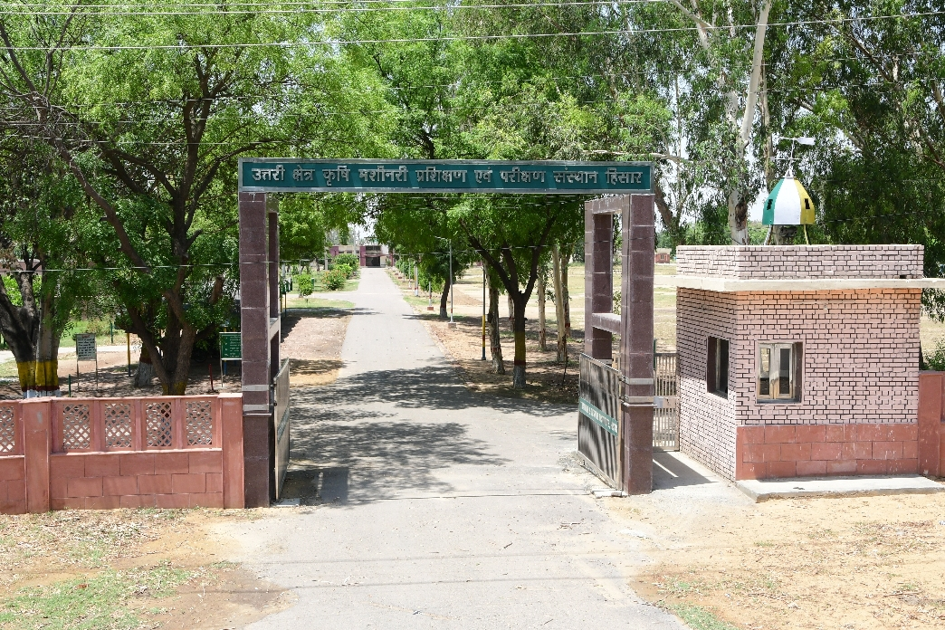
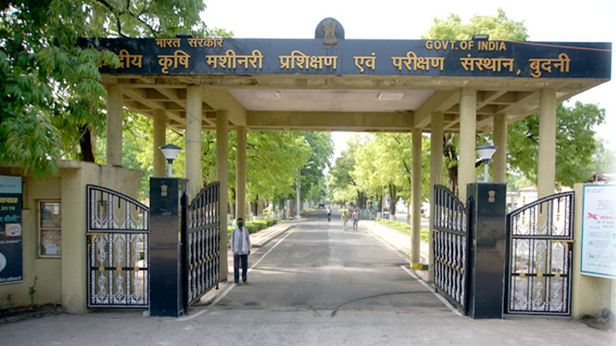
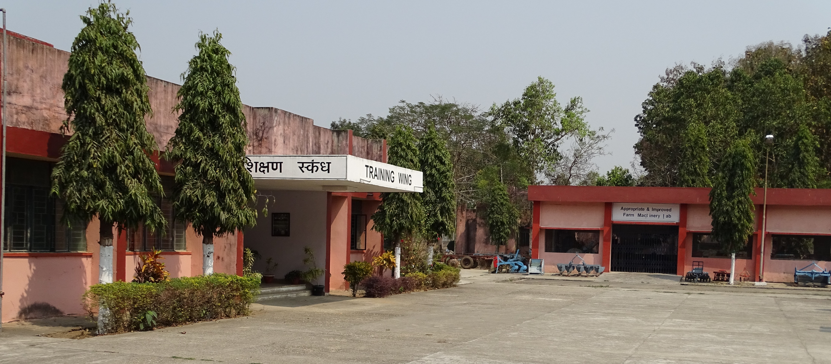
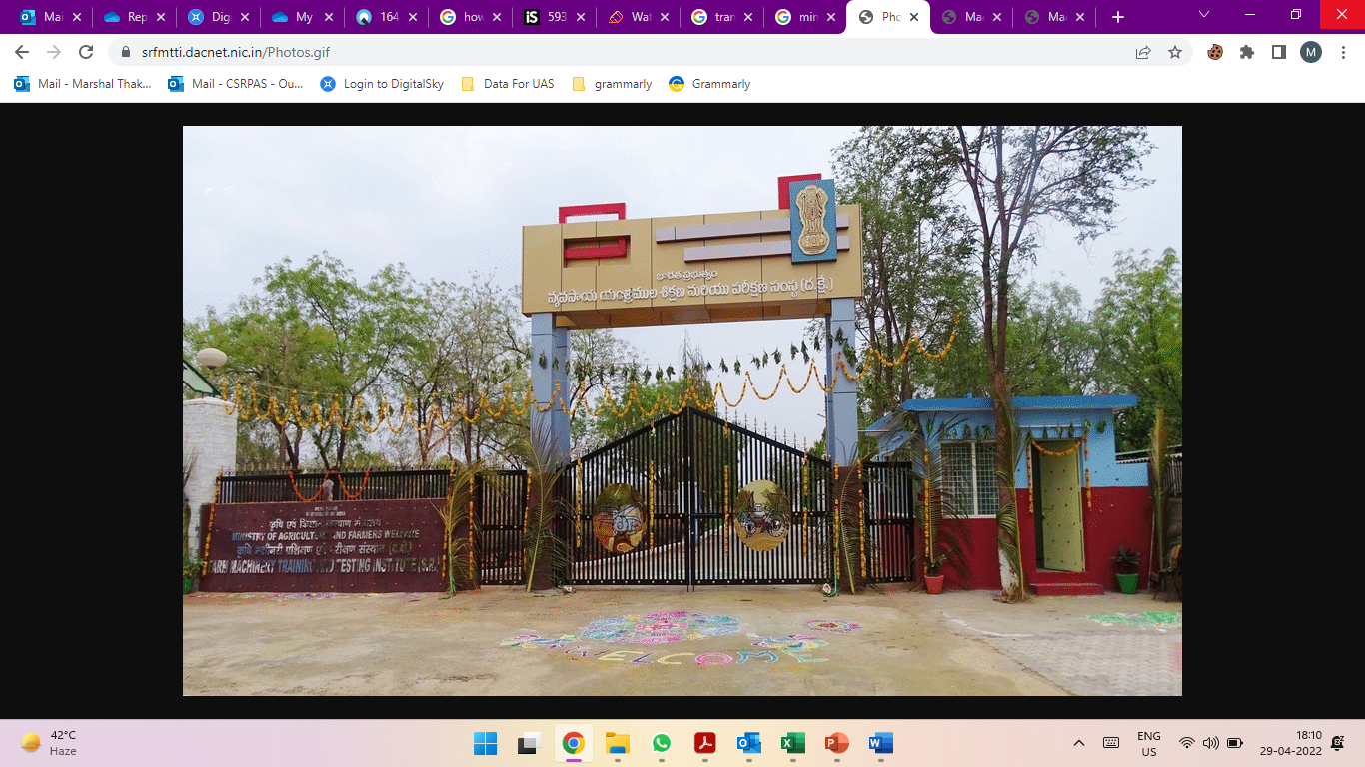
QCI quest to support Agri Drone Ecosystem
Seeks QCI intervention to assess FMTTI as CB (ATE)
GAP Assessment - FMTTI based in Hisar and Budhni
Assessment - DRR for FMTTI (Hisar) and FMTTI (Assam)
One SoC / TC for an Agri Drone may be issued
Notes:
MoA approached QCI to consider their FMTTIs for CB engagement.
- Haryana, Madhya Pradesh, Andhra Pradesh and Assam
FMTTIs participated in three brief sessions planned by QCI to develop into Testing Entities (TEs) under UAS scheme.
QCI, intends to enable an ecosystem where agri-drone manufacturers approach FMTTI offices for Type Certification.

Slide 9
MORE QUESTIONS PLEASE
Thank You for your attention!!!
For more details contact:
csrpas@qcin.org

