Slide 1



An Initiative of Drone/UAV Applications in Agriculture
“Integration and Application of UAV for Crop Health Assessment and Monitoring with IIDS
In
Providing Evidence Based Agro-Advisory Services to Farmers of North-East India (DHaBReT)”
Collaborating Institutes
Presenter: Dr. R.J. Singh
Asstt. Prof. (Agril. Extn.)
PI of DHaBReT
CPGS-AS, CAU(I),
Barapani, Meghalaya

Slide 2
Objectives
To perform multi-temporal aerial survey for mapping and monitoring of the identified crop for the defined project/study area.
To enhance the productivity of farm and empower the registered farmers by providing evidence based agro-advisory services generated by UAV data through IIDS platform.
To integrate, modify and implement through IIDS platform on the enhancement of farm productivity and empowerment of the registered farmers.

Slide 3
Sampling Plan Adopted

Slide 4
Project Workflow
Identification of Crops and Farmers
IIDS platform
Integration and Dissemination of EBAAS to the Farmers
UAV Flight Planning & Data Acquisition
Generation of Evidence based Agro-Advisory Services (EBAAS)
UAV Data Processing
3D Point Cloud, 3D Models, DSM, DTM, Ortho-mosaic Images
Custom Indices Generation
CPGS-AS & NESAC
Generation of Topographic Profiles and Cadastral Maps for the Project Sites
NESAC
Field Data
CPGS-AS
DIC

Slide 5
Progress of Project
(28th August, 2019 to 1st May, 2022)
S.No. | Project Activities | Performance
1. | Awareness programme of DHaBReT | 13
2. | Baseline Survey | Completed
3. | Customization / Enhancement of IIDS Farm registration / Language / Farm History | Under testing
4. | Registration of 600 Sample farmers for UAV Based Crop Mapping & Monitoring (100 each for Cabbage, Cauliflower, Paddy, Ginger, Turmeric and Pineapple) | Completed
5. | Mobile App for tracing of Farmers Field | - Do -
6. | Establishment of Agro Advisory Lab | - Do -
7. | Flight Planning of Identified 6 Crop | - Do -

Slide 6
Progress of Project
(28th August, 2019 to 1st May, 2022)
Contd.
S.No. | Project Activities | Performance
8. | UAV Data Acquisition & Data Processing for Point Clouds/ DSM/ DTM / Ortho Photo/ Vegetation Index. Generation of TIN, Slope and Aspect maps of Thynroit (Cabbage), Mawkriah (Cauliflower), Thandnongiaw (Paddy & Ginger), Kdonghulu (Paddy & Ginger), and Liarkhla villages (Paddy & Ginger). | 13 #s of UAV data acquisition (Continuous Process) Completed
9. | Ground Truthing - Sample Data Collection + Correlation with UAV Data Outputs | Performing (Continuous Process)
10. | Analysis of NDVI & Advisory to Farmers | - Do -
11. | Generated indices for determining the following soil attributes of Cabbage, Cauliflowers and Paddy of project fields (i) SOC, (ii) SMC, (iii) N, (iv) P, & (v) K | - Do -

Slide 7
Progress of Project
(28th August, 2019 to 1st May, 2022)
Contd.
S.No. | Project Activities | Performance
12. | Review meeting of the project amongst CPGS-AS, CAU (I), Umiam, Meghalaya; NESAC, Barapani, Meghalaya and DIC, New Delhi on 28.09.2021 being presided by Dr. Vinay Thakur, Senior Director DIC and Additional Director General, BISAG-N. | Monitoring of research project DHaBReT has been performed.
13. | Number of proactive calls providing Evidence Based Agro-Advisory Services | 212 #s
14. | SMSs pushed | 21 #s

Slide 8
Plan for next 6 (six) months

Slide 9
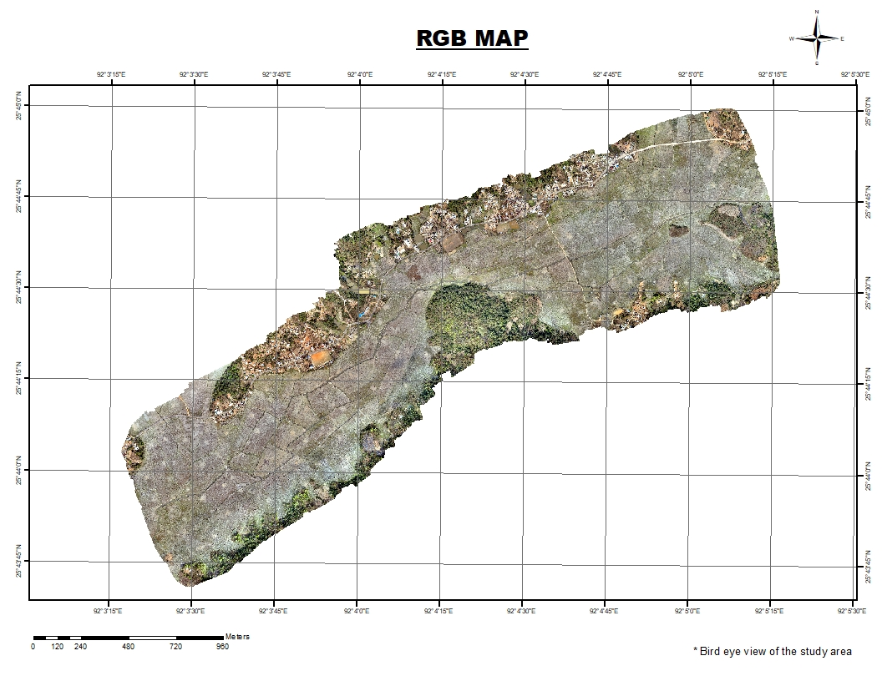
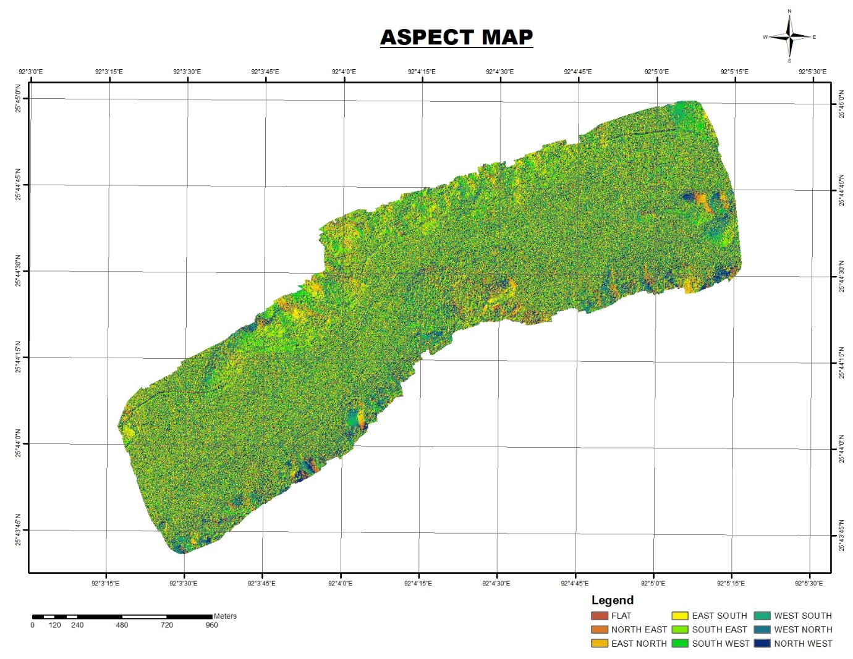
Outputs of Project
Plate 1: RGB & Aspect Maps of Paddy and Ginger Fields of Thadnongiaw, Kdonghulu and Liarkhla Villages of Bhoirymbong CRD Block, Ri-bhoi District

Slide 10
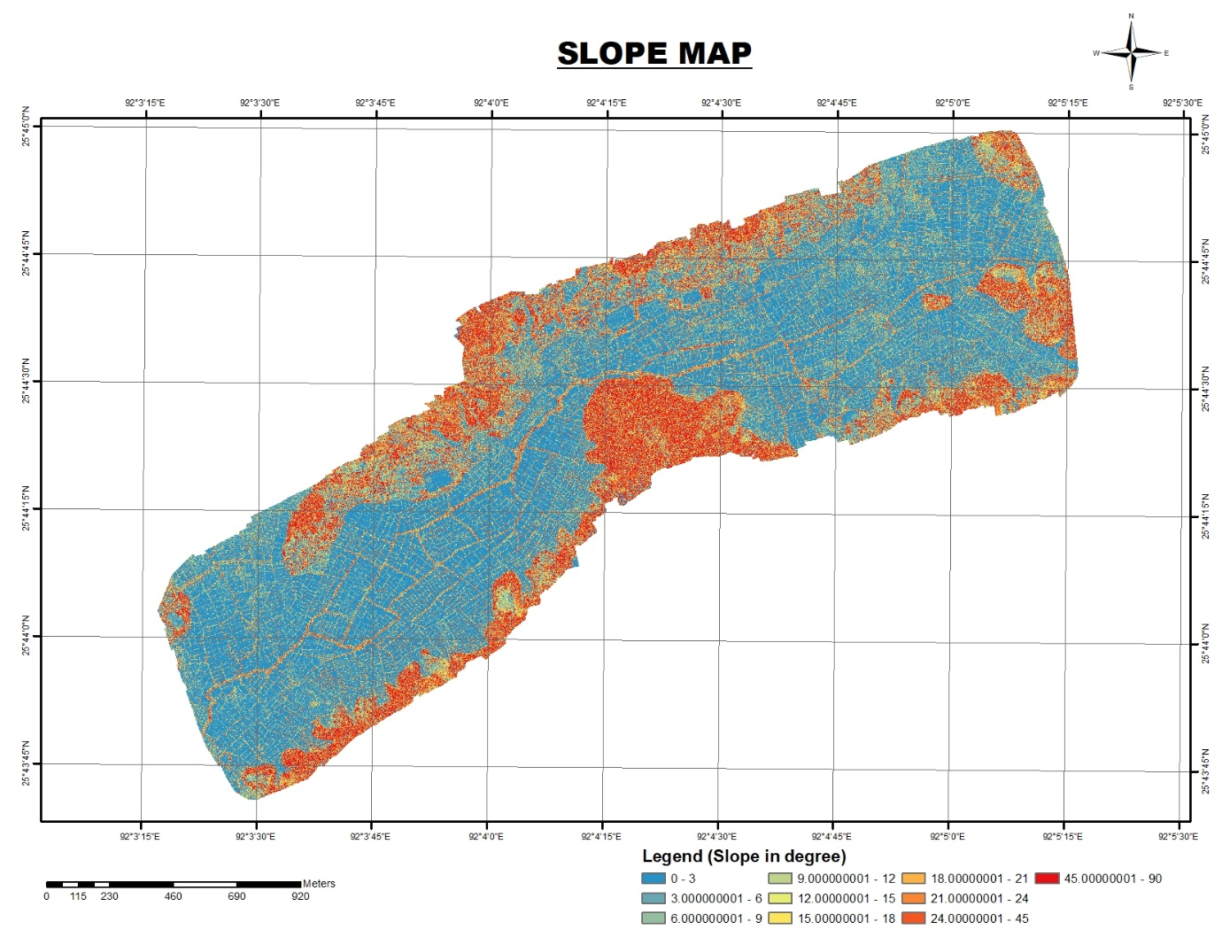
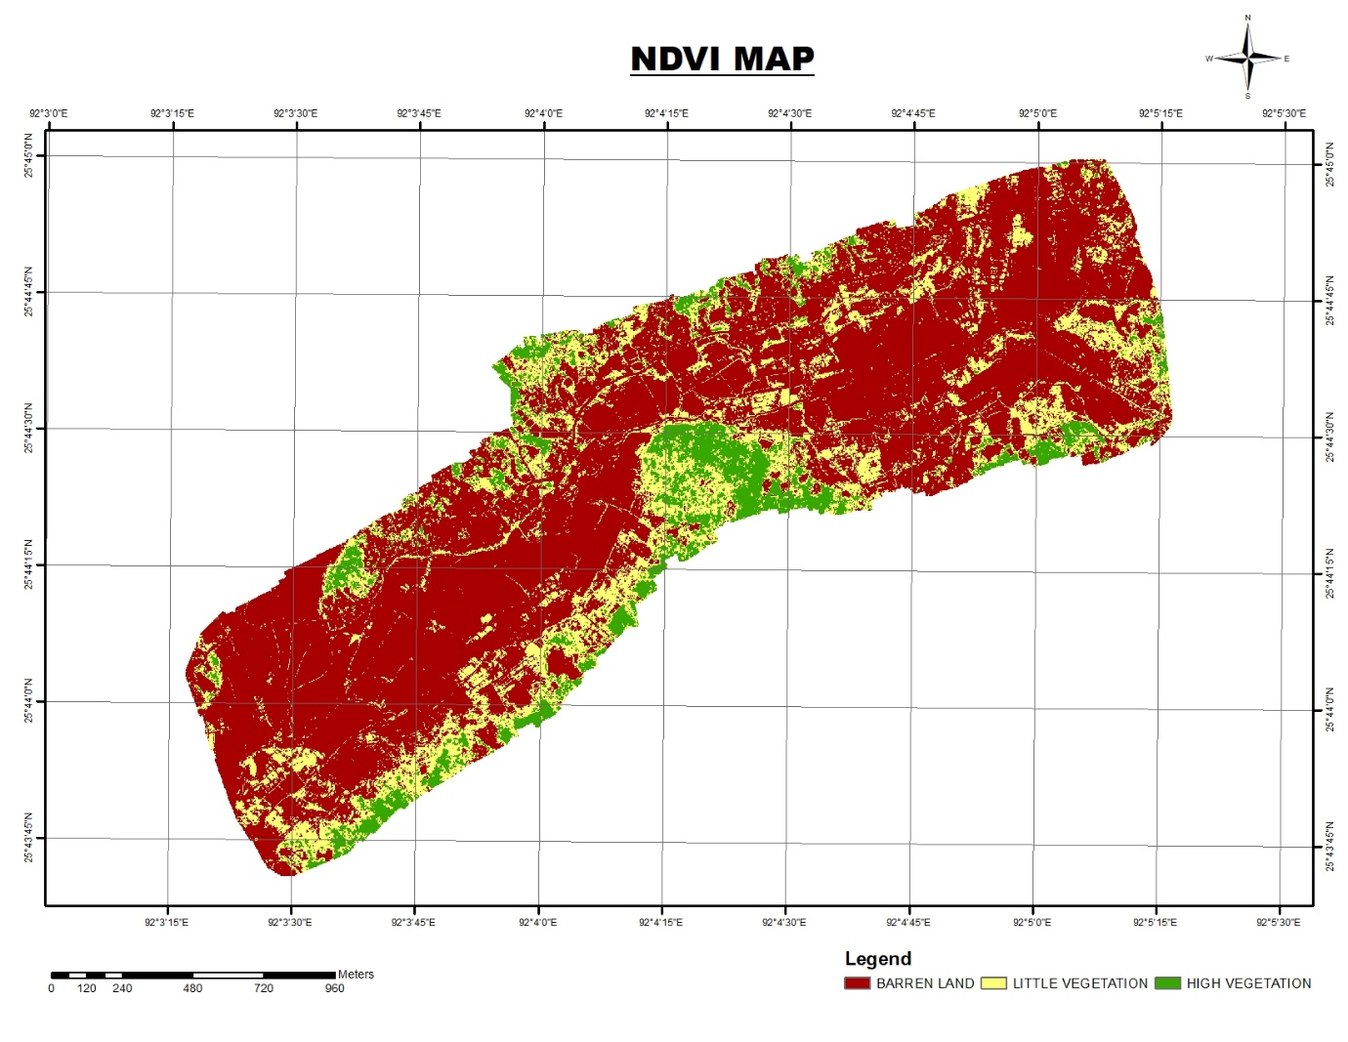
Outputs of Project
Contd.
Plate 2: Slope & NDVI Maps of Paddy and Ginger Fields of Thadnongiaw, Kdonghulu and Liarkhla Villages of Bhoirymbong CRD Block, Ri-bhoi District

Slide 11
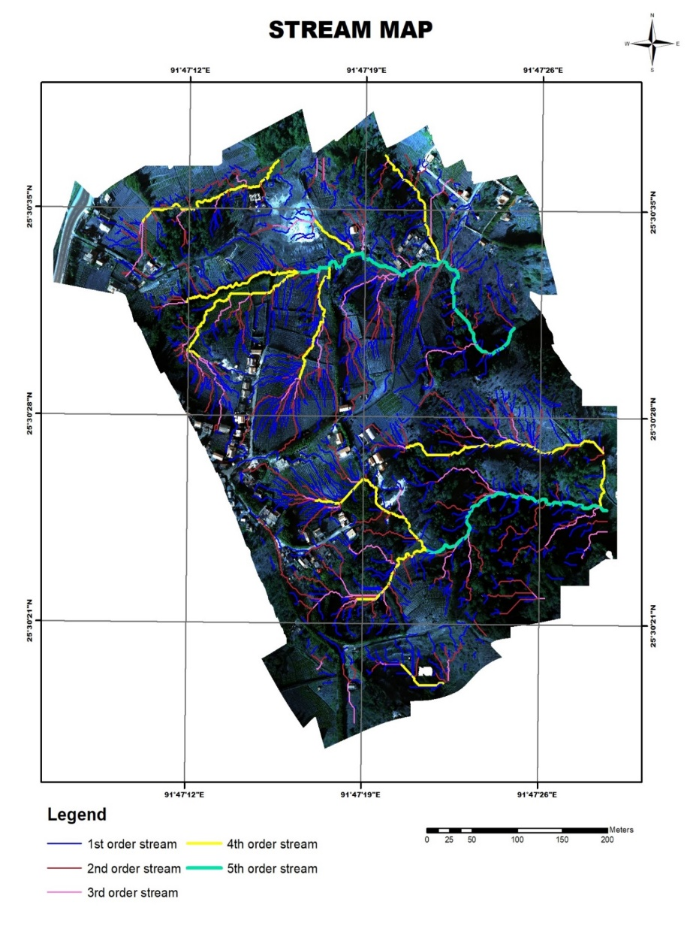
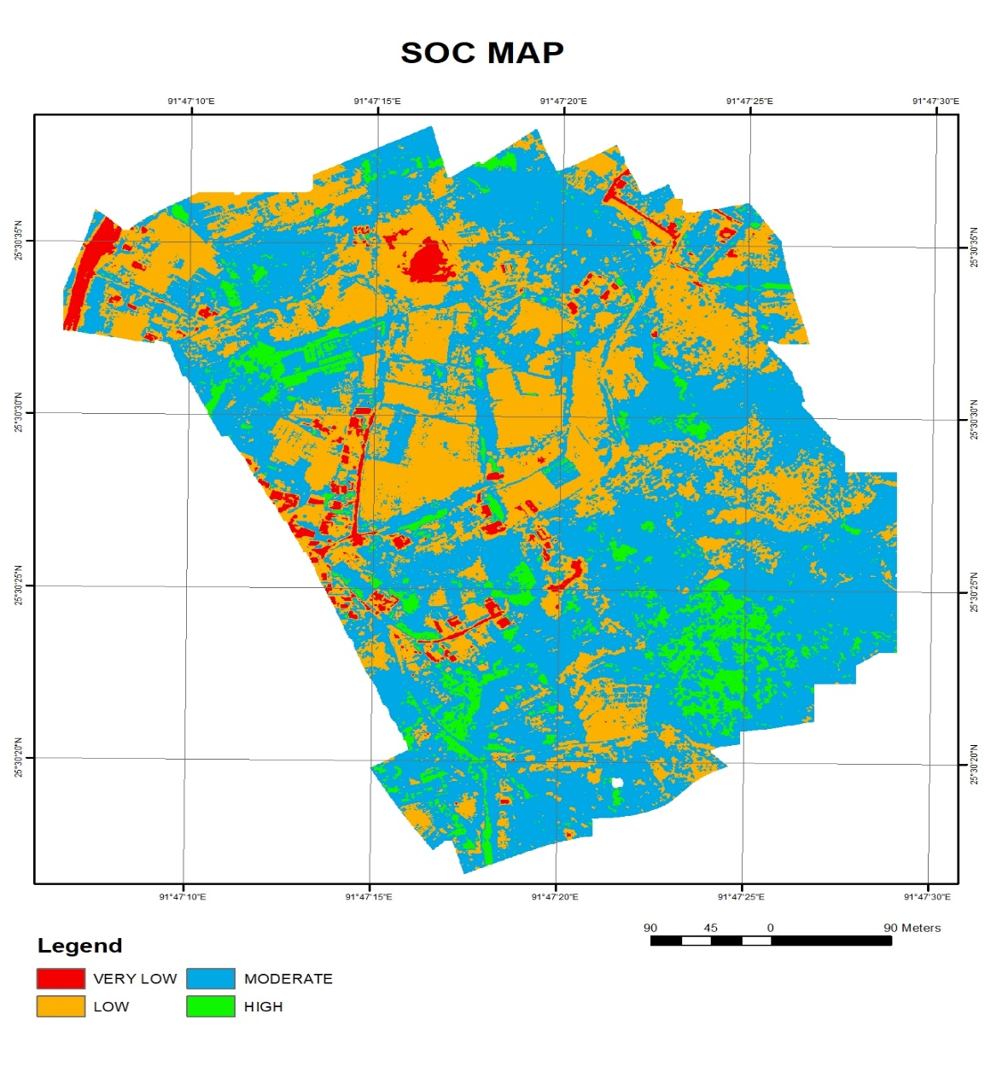
Outputs of Project
Contd.
Plate 3: Stream & SOC maps of Lumshohriew cauliflower villages in Mawkriah Village, East Khasi Hills District

Slide 12
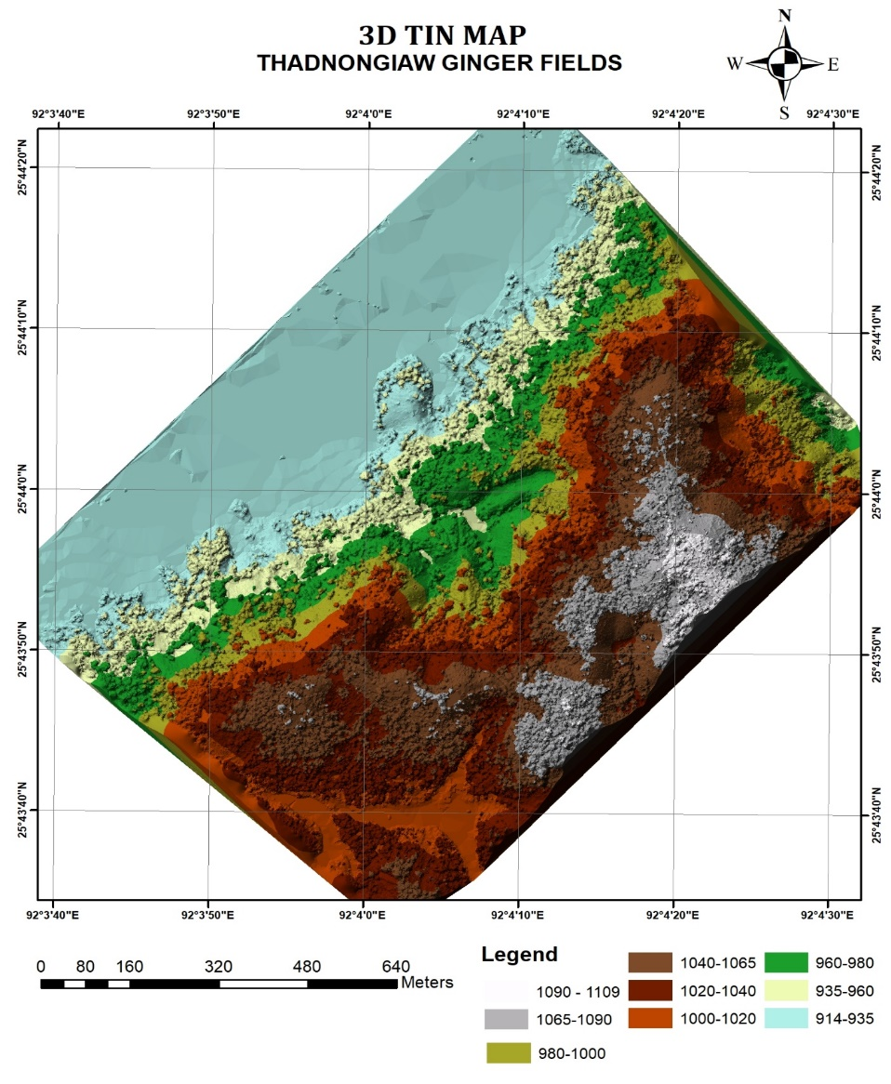
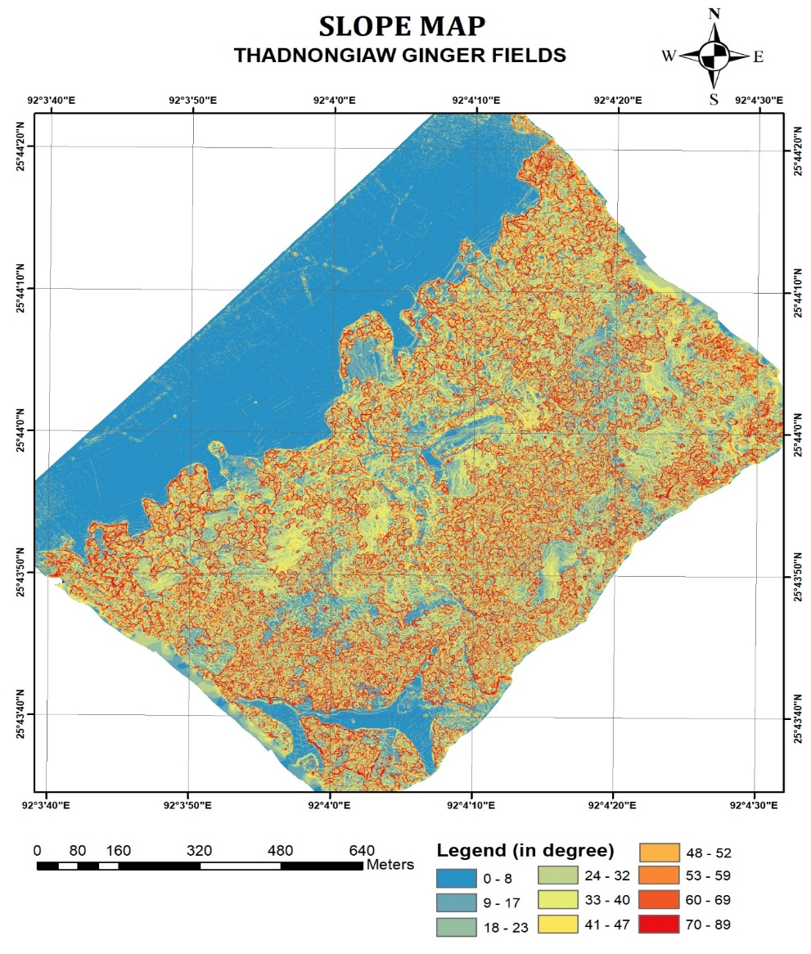
Outputs of Project
Contd.
Plate 4: 3D TIN & Slope maps of ginger fields of Thadnongiaw village, Ri-bhoi District

Slide 13
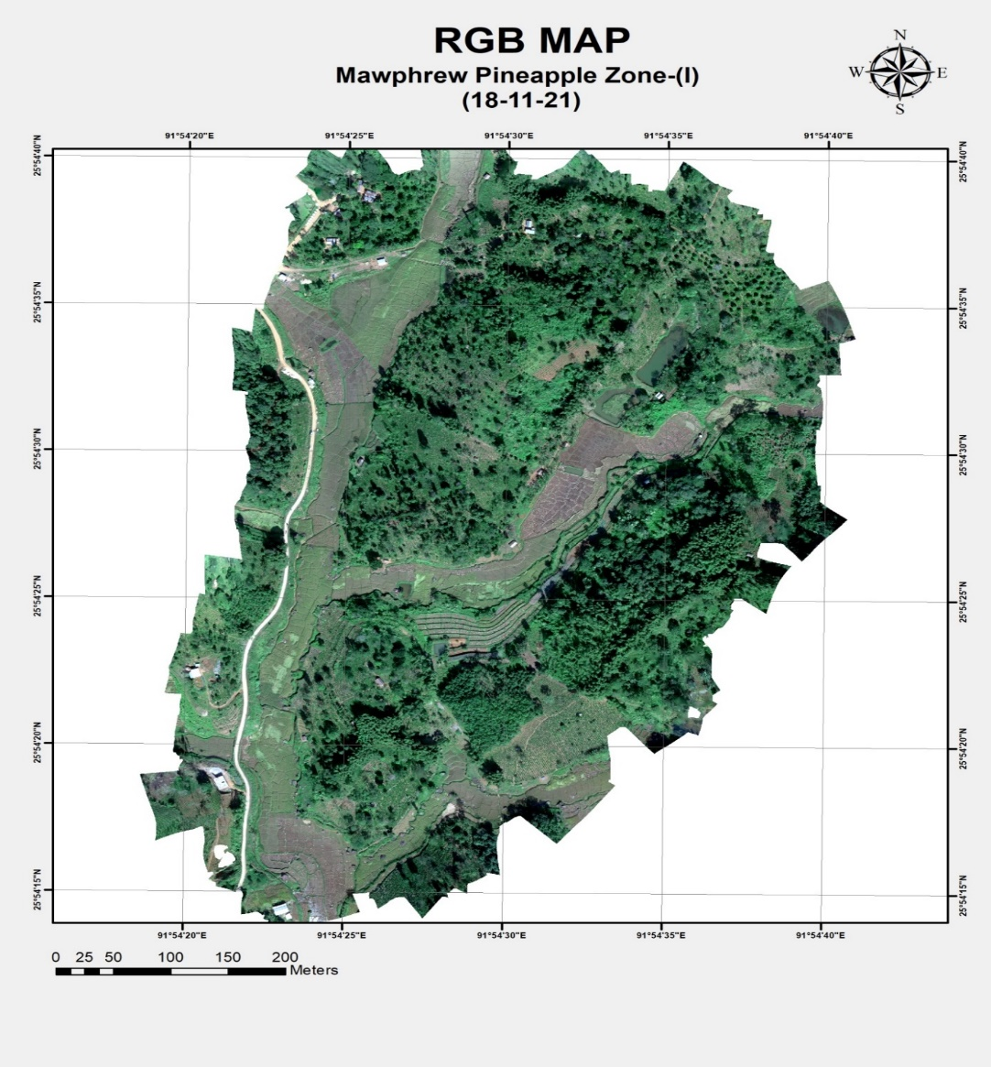
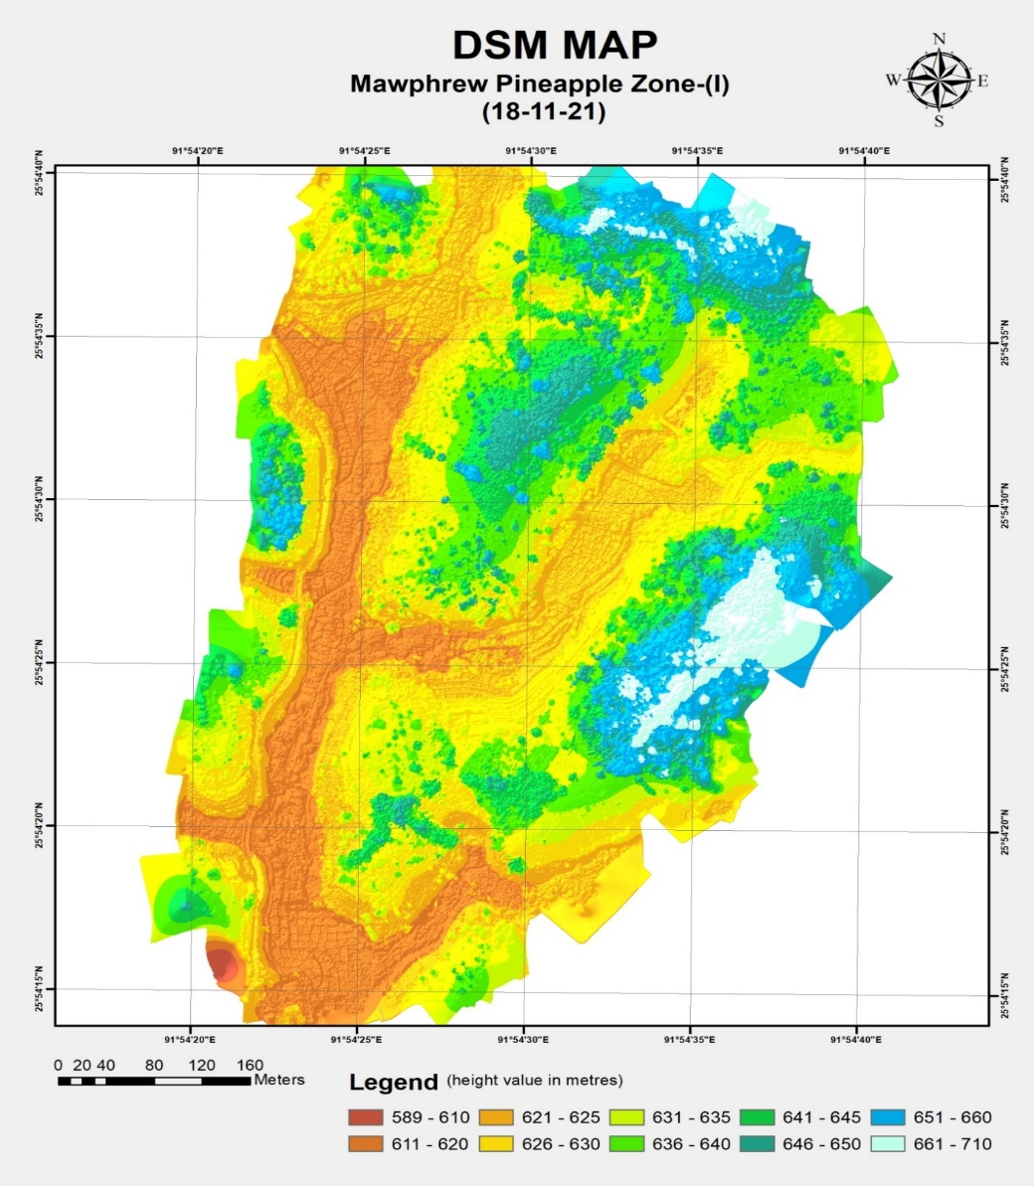
Outputs of Project
Contd.
Plate 5: RGB & DSM maps of Pineapple fields of Mawphrew village, Ri-bhoi District

Slide 14
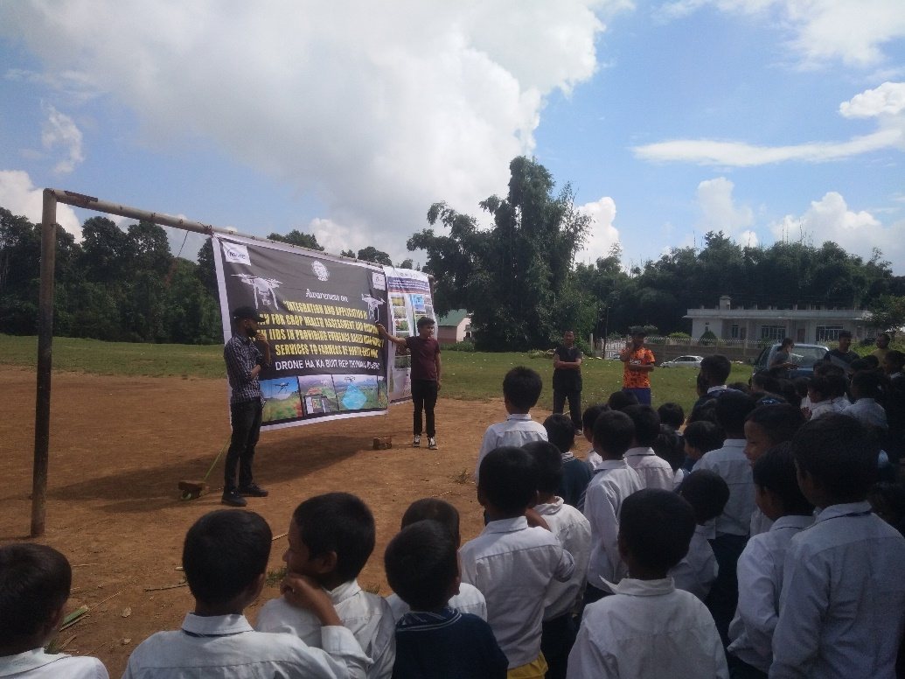
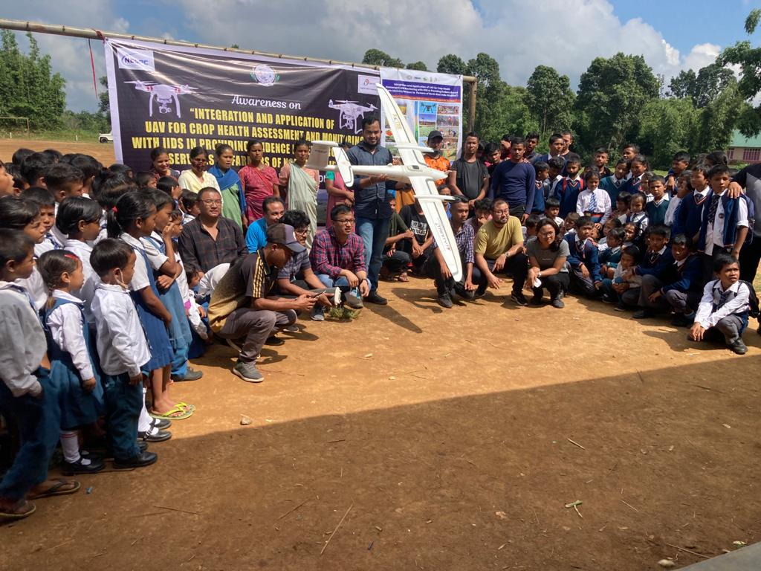
Drone Survey & Awareness Programmes
Plate 6: Awareness programme of DHaBReT to Turmeric farmers as well as school students of Nongkynrih High School at Laskein C&RD Block, West Jaintia Hills district

Slide 15
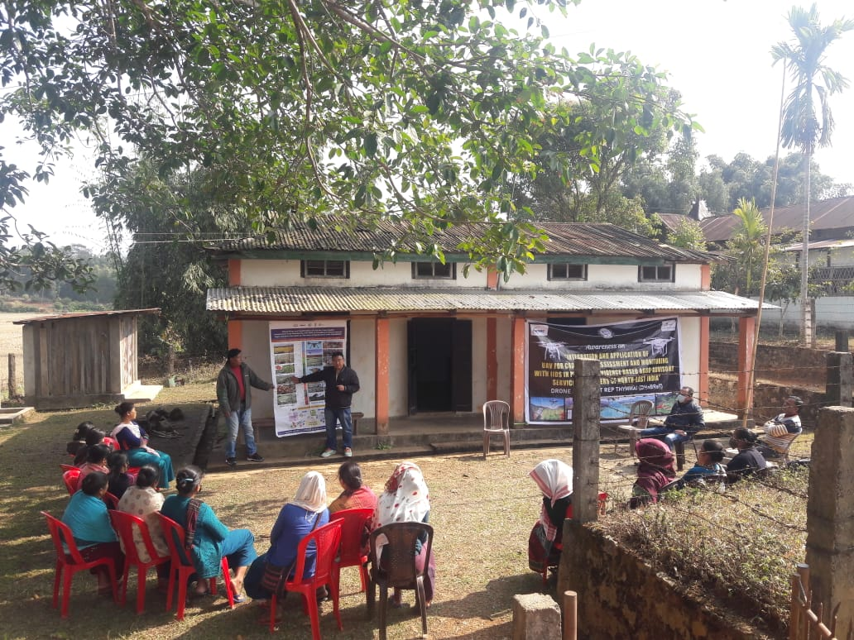
Drone Survey & Awareness Programmes
Contd.
Plate 7: Awareness programme of DHaBReT to Pineapple farmers at Marngar village, Ri-bhoi district

Slide 16
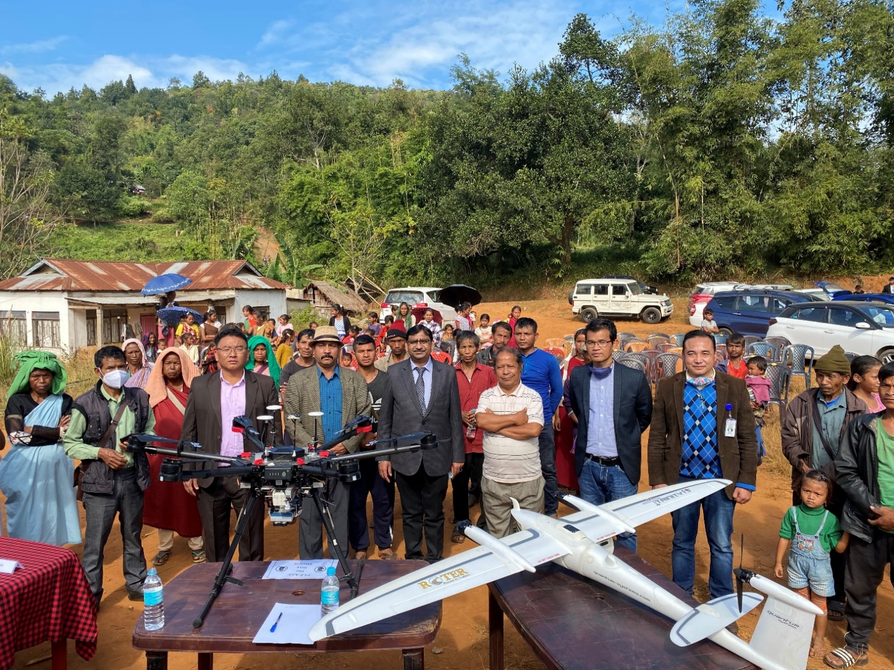
Drone Survey & Awareness Programmes
Contd.
Plate 8: Awareness of ‘DHaBReT’ vis-à-vis observation of ‘Meghalaya Farmers’ Day’ on the 4th of December, 2021 at Nongmawlong Village, Umsning C&RD Block, Ri-bhoi, Meghalaya on his auspicious presence of Dr. Dr. S.P. Aggarwal, Director, NESAC, Deptt. of Space, GOI, Umiam, Ri-bhoi, Meghalaya

Slide 17
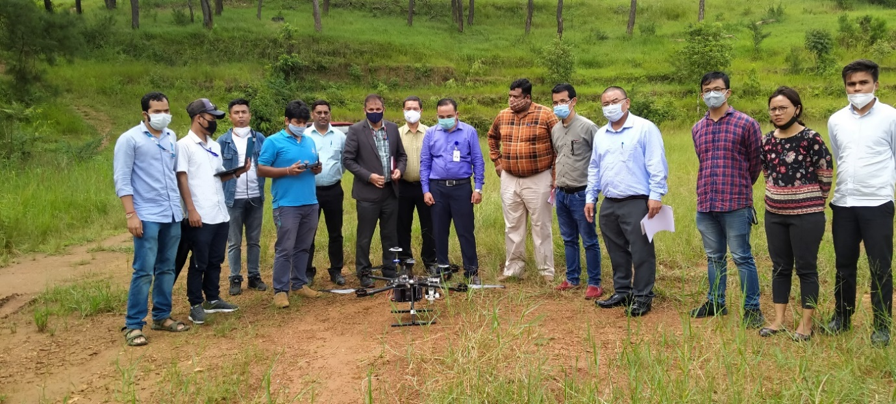
Field Demonstration and Monitoring Visit
Plate 9: Field demonstration of Multirotor UAV data acquisition to Hon’ble Dr. Vinay Thakur, Senior Director DIC and Additional Director General, BISAG-N and other scientists of DIC at NESAC on 28th September, 2021

Slide 18
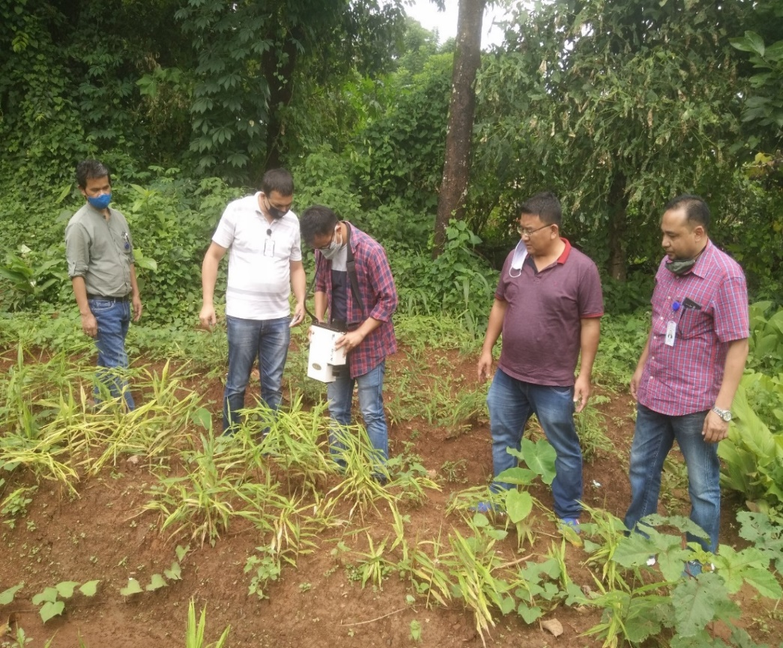
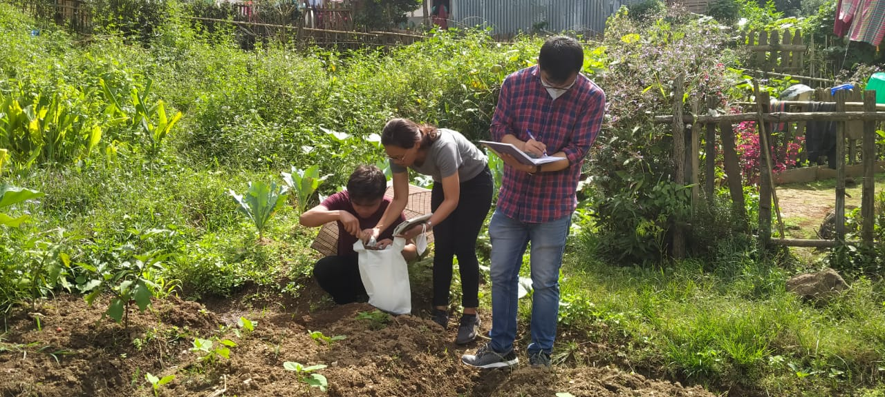
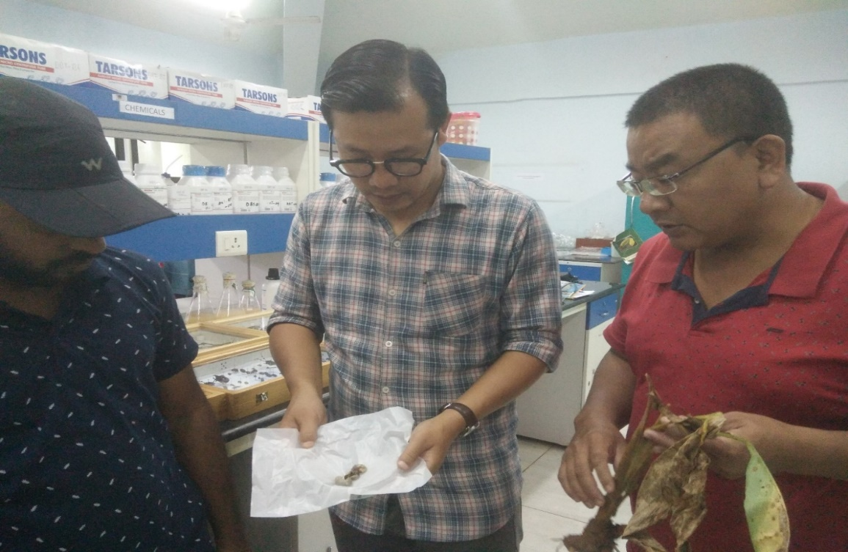
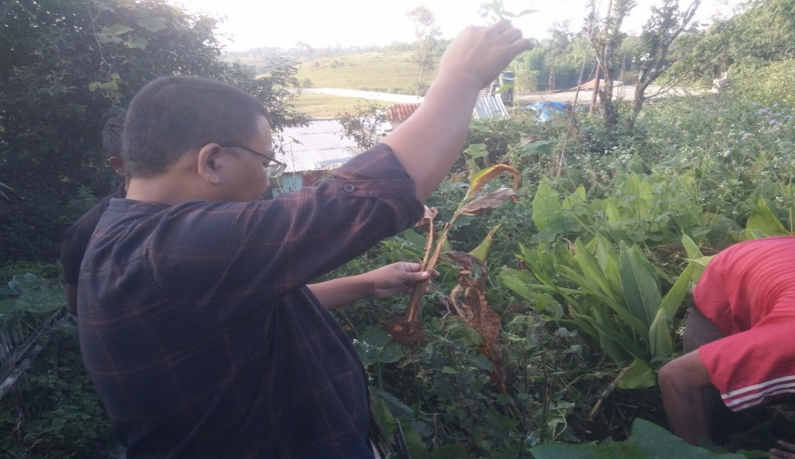
Plate 10: Samples collection from project fields and its laboratory analysis for triangulation with UAV data

Slide 19
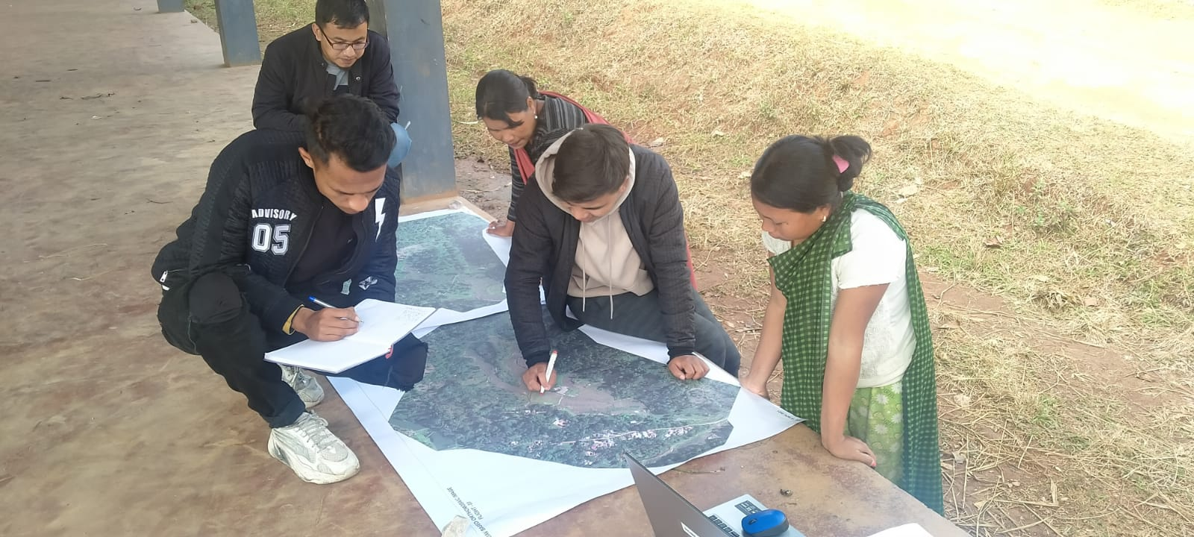
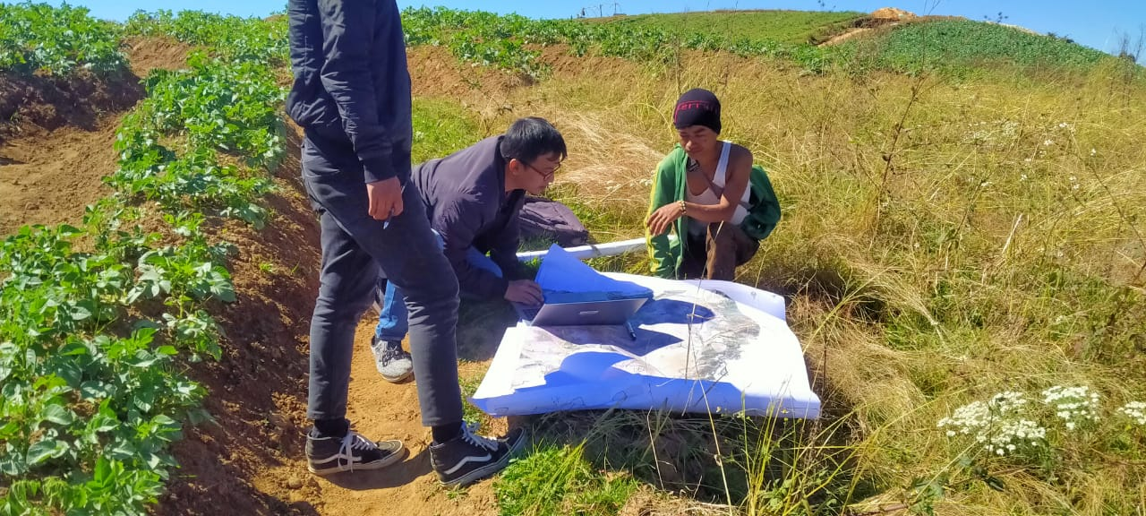
Farm Demarcation Using Drone Image
Plate 11. Participatory demarcation and triangulation of UAV data on farmland boundaries and areas.

Slide 20
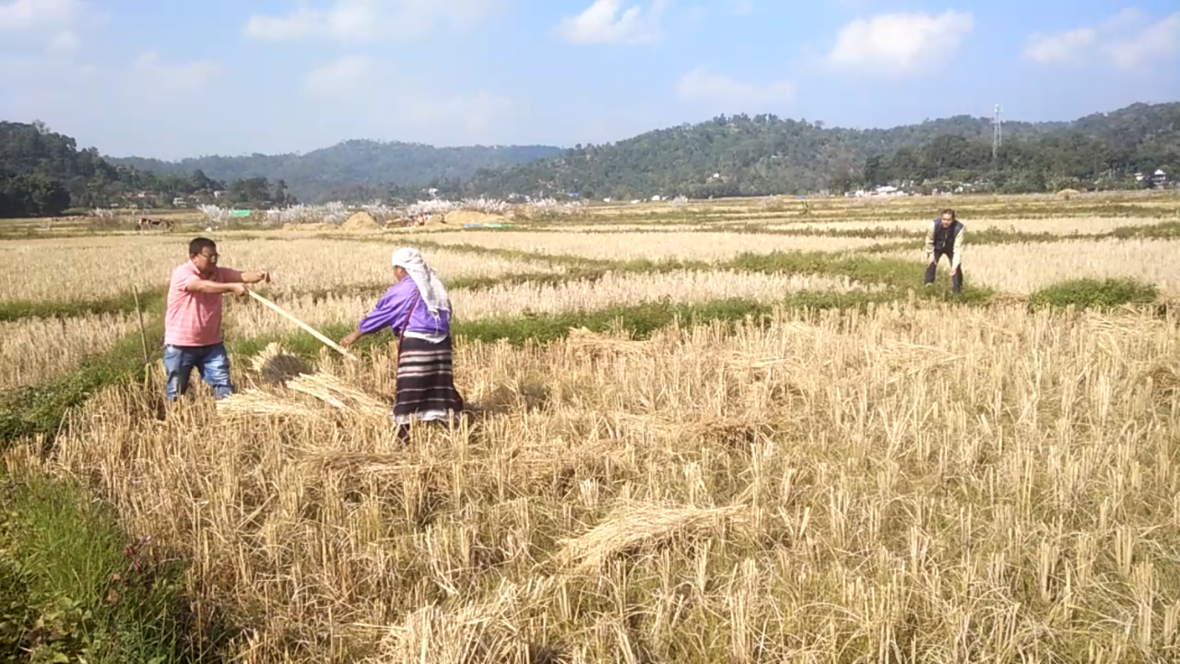
Participatory Validation
Plate 12: Determination of yield of paddy from the groundtruth area of 10x10 m² at Thadnongiaw village

Slide 21
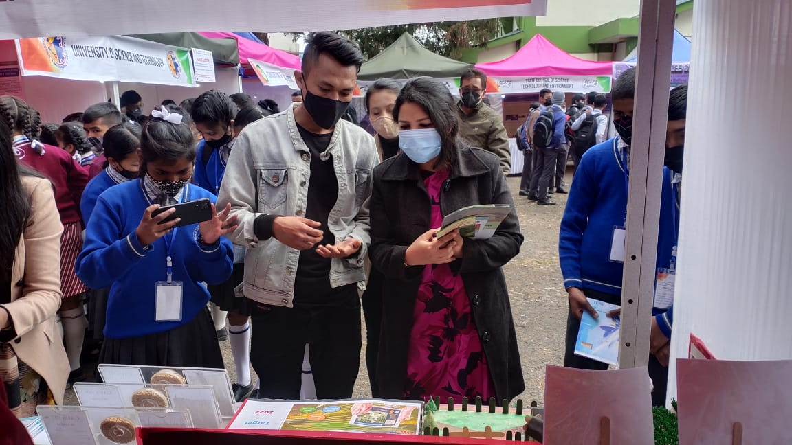
Other extension activities of DHaBReT
Plate 13: Showcasing of model-exhibit and explanation about DHaBReT to participants/visitors by project staff on National Science Day Exhibition on 28.02.22 at ‘All Saints Hall’, IGP Point, Shillong, Meghalaya.

Slide 22
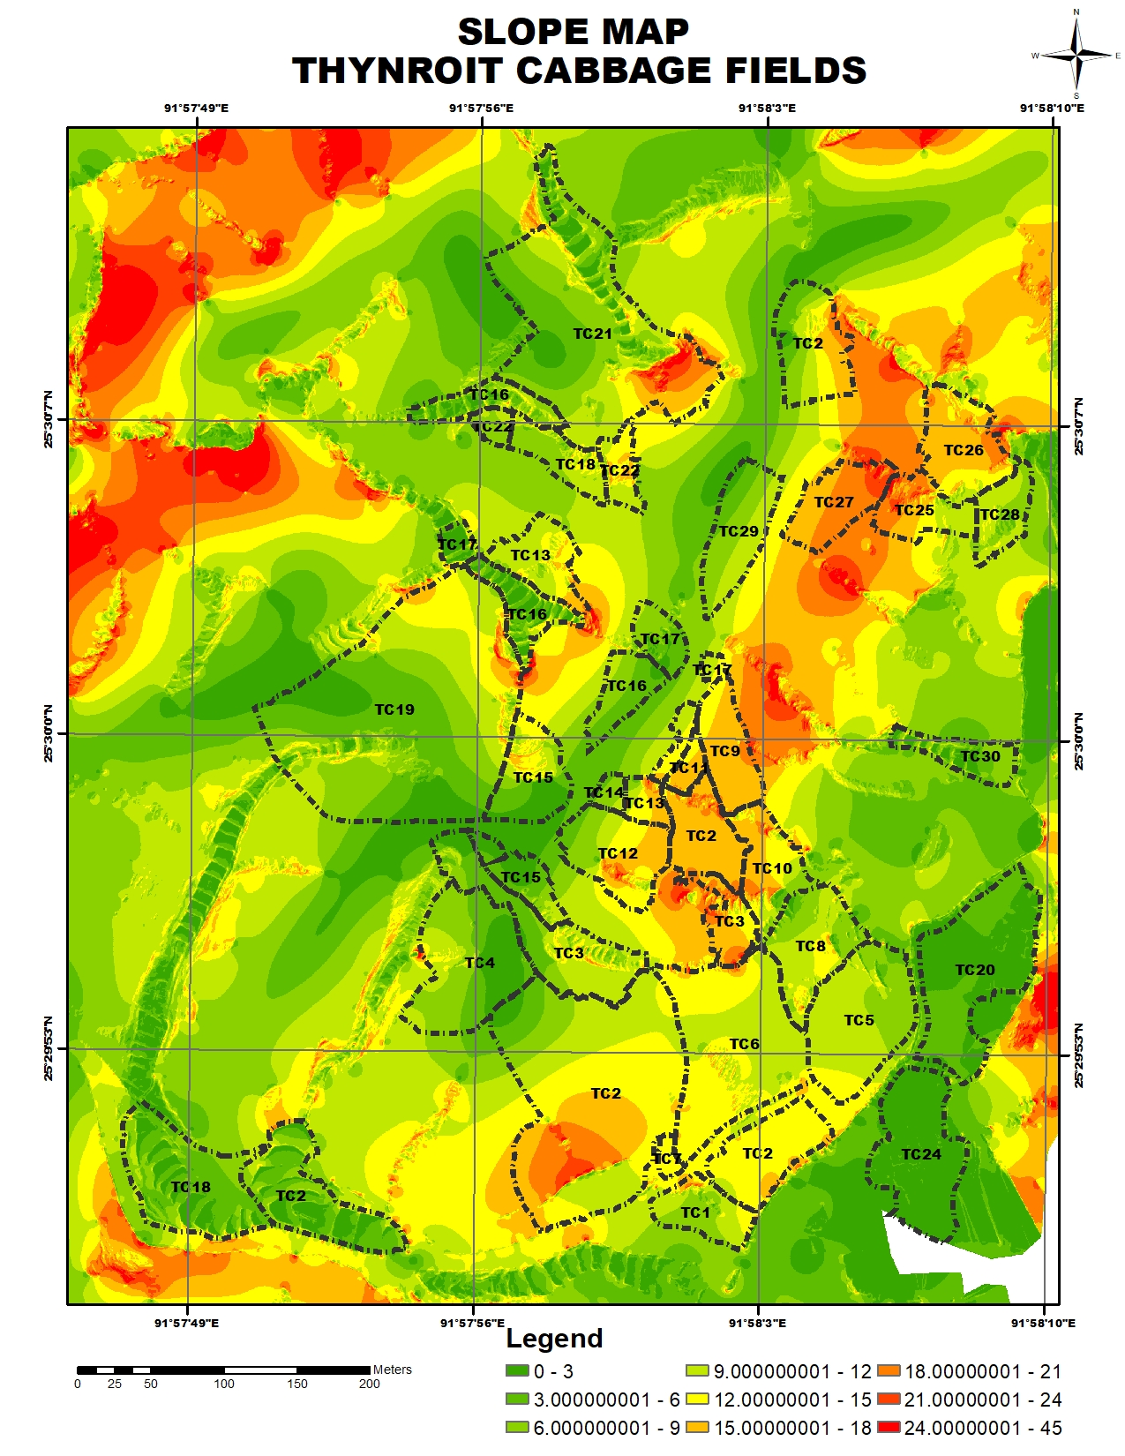
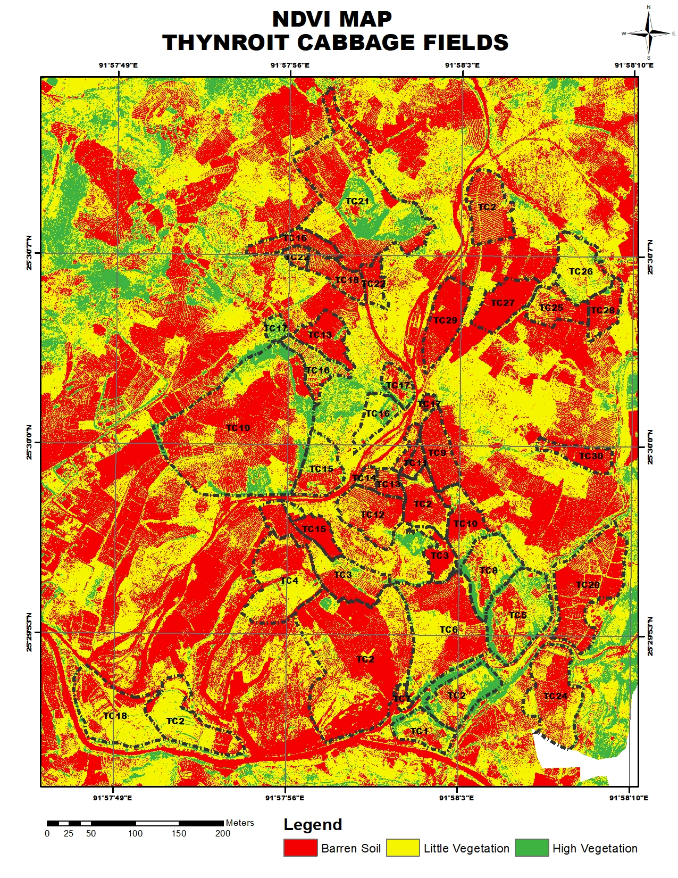
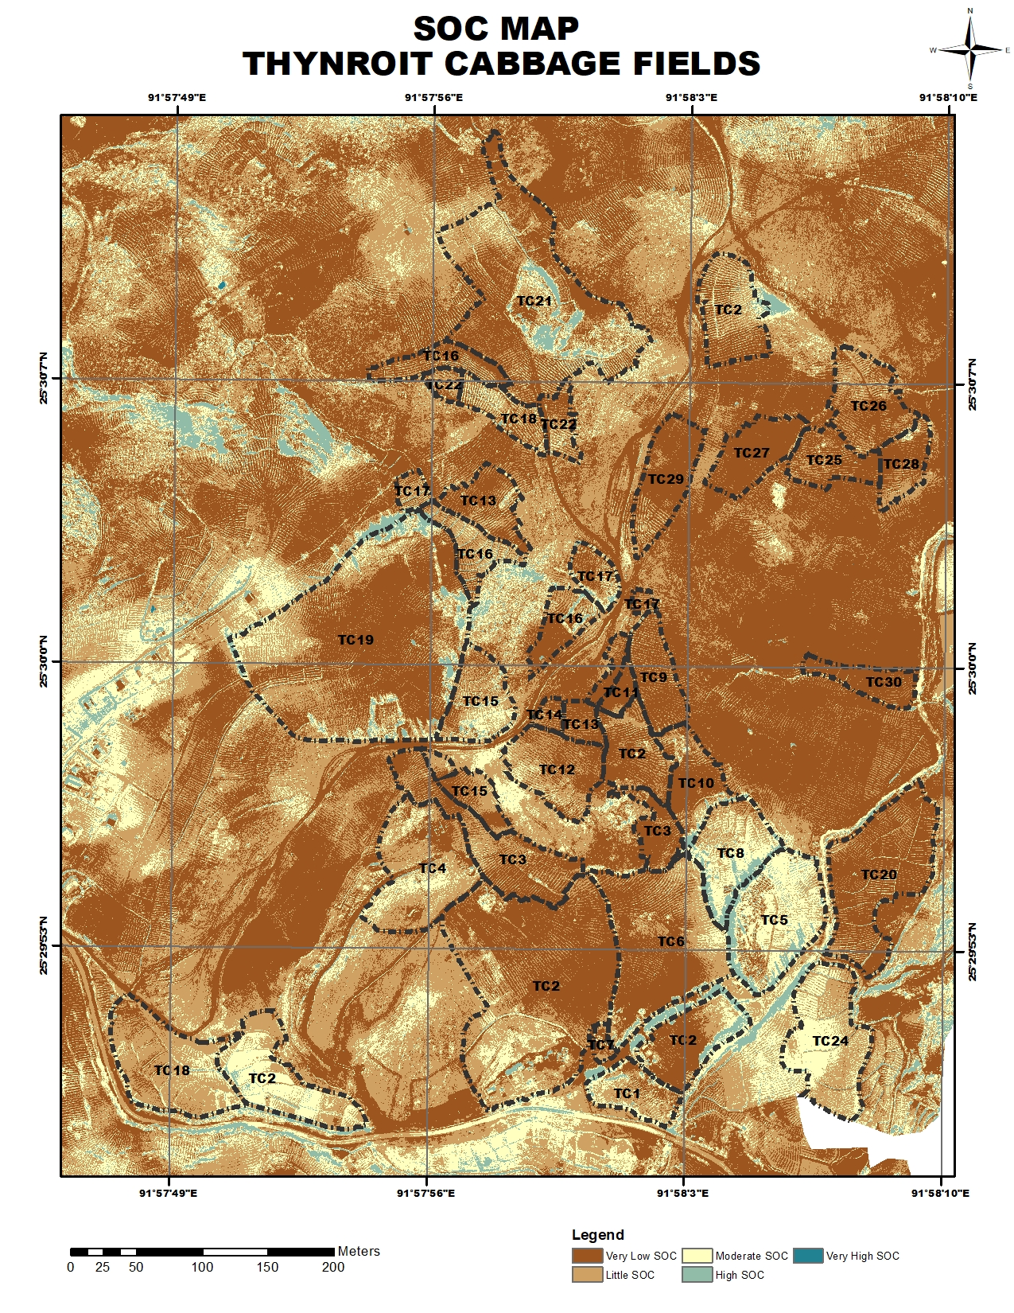
Information to be available on IIDS for Advisories
DHaBReT
Crop: Cabbage | Plant Stage: | Name of Farmer: | Area of Field: | Location: Geotagged
2D Map | 3D Map
Soil Health (with change analysis) NDVI, SOC, SMC etc. | DSM, TIN etc. (with change analysis)
Statistics | Advisories
 | Introduction of Minimum Tillage Maintain and conserve ground cover in between rows. Avoid mono-cropping. Go for crop rotation and mixed cropping. Incorporate multiple application of manure and compost from different sources viz., cattle, poultry, plant waste. To apply more towards North-West direction.

Slide 23
Benefits of Research Project
Benefits towards SCIENTISTS | Benefits towards FARMERS
Effective in Monitoring, Scouting and Control of Pest & Diseases of crops. | Near Real Time Précised Agro-Advisory Services w.r.t. crop stress – diseases, insects, weed control measures and nutrient deficiencies.
Drone Imagery – High Resolution 3D Maps will provide accurate farm data. | Yield forecasting of crops, identification of appropriate harvesting time & Yield Gap Analysis is possible.
Precise analytics for prompt actions | Mitigative and adaptive measures in crop production after extreme weather events / natural calamities
Possible to provide evidence based agro-advisory services through IIDS | Enable to reduce requirement of farm labour / farm drudgery.
Provision for in-depth research work on plant based image data analysis on different agricultural and horticultural crops not only for scientists/faculties but also to students. | Development and execution of profitable Farm Business Plan.
Geo-tagged farm details for each and every registered farmers. | Market Linkage of produce.

Slide 24
THANK YOU

