Slide 1
Regulatory Overview, Issues and Future Plans
2 May 2022

Slide 2
Agenda
Regulatory Overview
  Rules & Regulation – update
  Digital Sky Platform
Key Issues (Agriculture as a use case)
Future Plans
  DigitalSky Phase 2 Features

Slide 3
Rules & Regulation - Update
12th March, 2021 → Rule 15 A and CAR Section 3, Series X, Part – I was superseded by the UAS Rules, 2021 published by MoCA in the Official Gazette
25th August, 2021 → The UAS Rules, 2021 was repealed by “The Drone Rules, 2021
24th October, 2021 → The National UTM Policy Framework was published by MoCA
26th January, 2022 → The Certification Scheme for Unmanned Aircraft Systems was published in the Official Gazette

Slide 4
Rules & Regulation - Update
The Drone Rules, 2021*
National UTM Policy
Certification Scheme for UAS
All Drone need to have UIN
All Remote Pilots should have undergone training from authorized RPTO & have obtained RPC [Nano & micro non commercial exempted]
All type/ models of Drones should have a type certificate [Model and Nano category exempted]
No operator/ operation permit in Green Zones
ATC permission is required in yellow zone
In red zone (a.k.a. geo zones) prior permission is required from MoCA & red zone owner
Mandatory Insurance [Nano category exempted]
Details Stakeholders;
UTM Architecture;
Real time identification & tracking;
UTM deployment plan; and
Scope for conducting UTM experiments
Certification Criteria (minimum requirement for airworthiness) for certification of UAS [upto medium category (<150kg)]for the following scenarios:
  Flying in VLOS
  Flying in Day & Night
  Flying below 400 ft AGL
Acceptable standards & methods of evaluation
Accreditation / authorization of testing entities/ certified bodies
* Applicable upto 500kg

Slide 5
DigitalSky Platform
The development of DigitalSky Platform has been undertaken with a dual purpose of supporting the growth and regulation of drones ecosystem in India. The RFP (Tender) was floated by AAI for MoCA. Purchase Order (PO) for Digital Sky was awarded to M/s Happiest Minds Technologies Limited, Bengaluru on 1st August, 2019. The project as such is managed/monitored by AAI with the approval of MoCA. The platform shall enable below features at a high level:-
About the platform
Enable Regulated Drone flights regulation across the country
Provide Single Window Service to its service providers as well consumers
Provide regulators and approvers a dashboard to monitor the operations in the sky.
Tracking and analyzing flights and its related data
Scalable, robust and secure ecosystem
Will be available through web, android, iOS
Key Features
Registration of Manufacturers/Drone Owners, Operators, Pilots, Remote Pilot Training Organizations etc
Type Certificate – Application and Issuance (D1)
Unique Identification Number (UIN) – Request, Issuance (D2) and Transfer & Deregistration (D3)
Certification for Pilots (D4) & Remote Pilot Training Organizations (D5)
Airspace Management
Flight Plan – Creation & Approvals
Incident reporting & tracking
Monitoring & Analytics

Slide 6
DigitalSky Platform – Key Actors
Consumers and
Service providers
Regulators and Approvers
DGCA
MoD
AAI
MoCA
MHA
Police Departments
QCI / ATE
Other Departments
Manufacturer / Importer
Operator/User/Owner for drones
Remote Pilot
Remote Pilot Training Organization

Slide 7
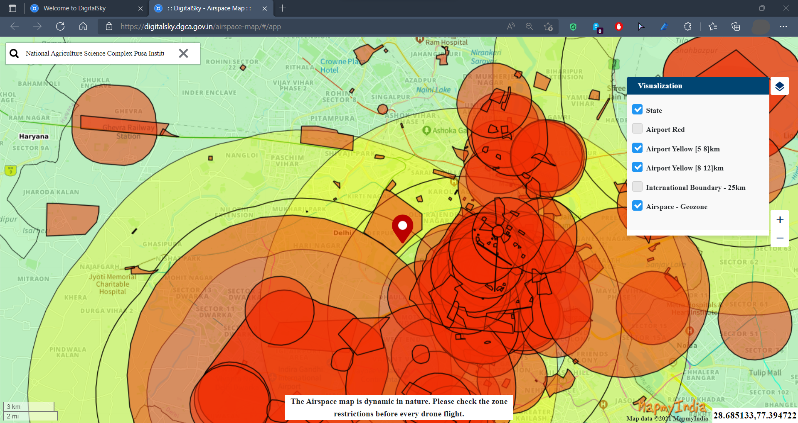
DigitalSky Platform– Interactive Airspace Map
Red & Yellow Zones around NASC
https://digitalsky.dgca.gov.in/airspace-map/#/app

Slide 8
Key Issues (Agriculture as a use case)
Non availability of Certified Drones (Type Certified)
Shortage of trained remote pilots/Instructors
Shortage of component and part of Agri- Drones
Digital Sky Platform- It is under Phase 2 development and other features like flight planning, UTM, situational awareness, Remote Pilot certificates etc will be added in due course.

Slide 9
Future Plans- Digital Sky Phase 2 Features
Phase 2 – Set 1
Phase 2 – Set 2
Phase 2 – Set 3
D1 form – Application for Type Certificate
D2 form – Application for UIN
D3 Application for UIN transfer
Airspace Map
Airspaces creation support
D4 Form – Application for Remote Pilot Certificate
D5 Form – Application for RPTO Authorization
Type Certificate, Pilot Certificate Generation
QCI/ATEs onboarding for Type Certificate workflow
Flight plan submission
AMSS Integration & visualization
AMSS Integration Enhancements
Situational Awareness enhancements
BVLOS operations
Suspension, cancellation, revocation of permissions
Timers for SLA
Two-way communication
Reports
Compliance to Drone Rules 2021

Slide 10
Thank You !

