Slide 1
“PROMOTION OF KISAN DRONES"
K. Singh
DDG (Agril. Extension)

Slide 2
Kisan Drone Application
Capacity building of Scientists/SMSs for creating a pool of trained pilots by organizing training of trainers/instructors through DGCA or other approved organizations;
Conducting demonstrations on Drones in different agricultural operations in the farmers' fields;
Motivating and training farmers on use of "Drones" for crop spraying and other farm operations; and
Handholding to Agri-preneurs/Start ups

Slide 3
Out scaling of Kisan Drones during 2022-23
Particulars | KVKs | Agril Universities | ICAR Institutes | Total
No. of Project Implementing Centres (PICs) | 100 | 25 | 25 | 150
No. of drones per centre | 1 | 2 | 2 | 5
Total no. of Drones proposed to centres | 100 | 50 | 50 | 200
Capacity building of 2 scientists/SMSs as Drone Pilots per centre | 200 | 50 | 50 | 300

Slide 4
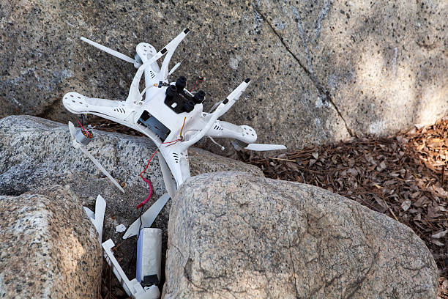
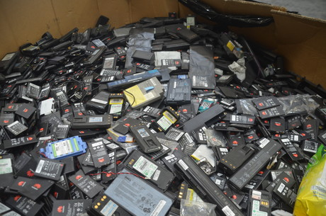
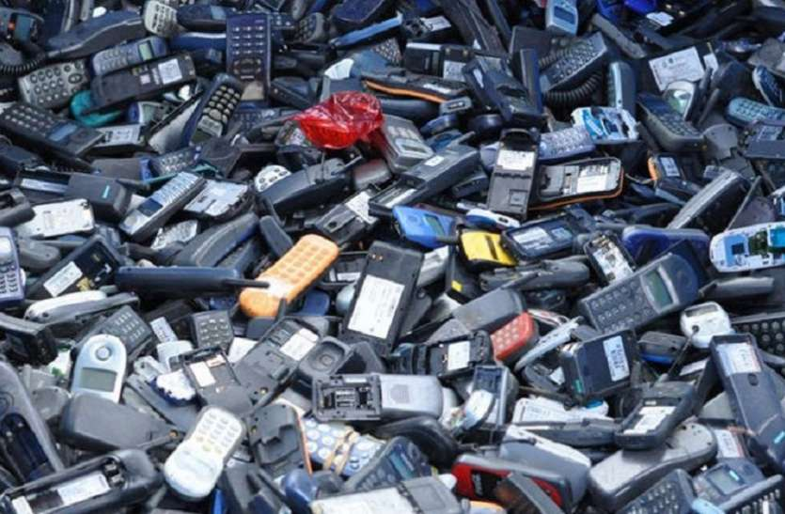
Challenges
Flight Time and Range
Technical experience
Farming practices
Local awareness
Weather Dependent
Knowledge and Skill
Misuse
Software crashes
Lability
Batteries, disposal, e-waste
Disposed old battery
E-Waste

Slide 5
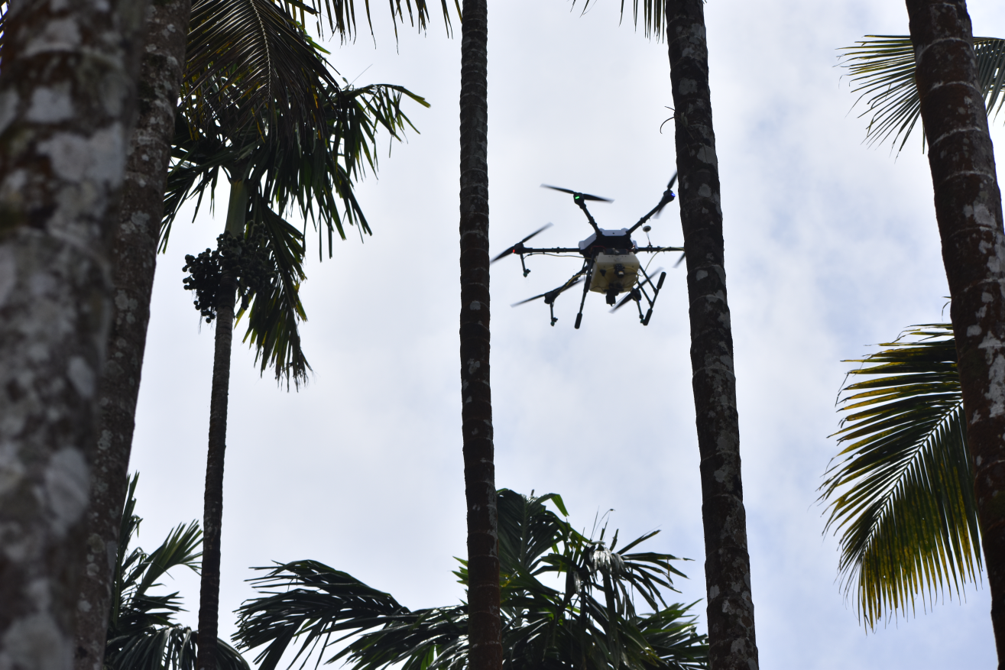
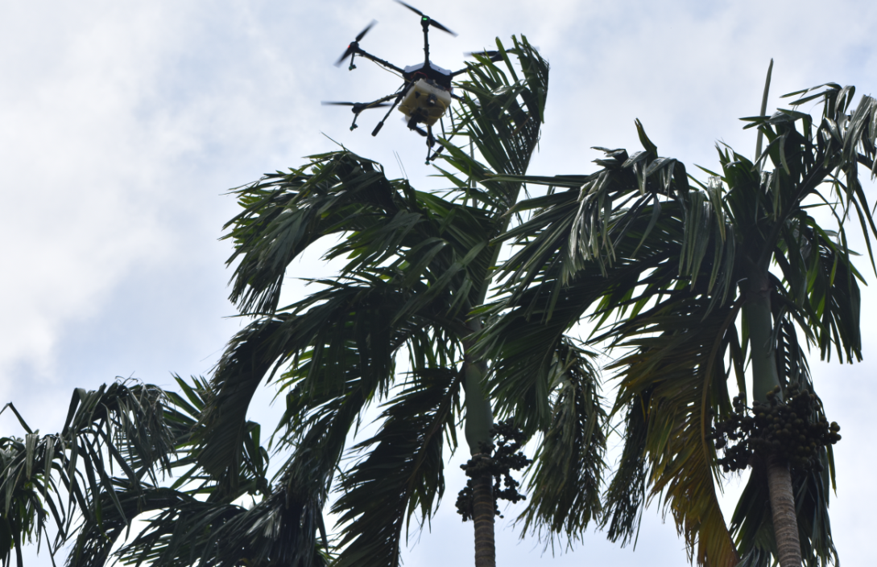
Difficulties in operation of drones on fruit trees
Only foliar spray above the canopy is possible
Spraying to Inflorescence/Nut is not possible as drone cant enter into the garden.
Disturbance to the fronds is observed
Drones demonstrated at 287 KVKs
Difficulty in spraying to nuts/inflorescence
Disturbance to the fronds
Source: KVK Uttar Kannada, Karnataka

Slide 6
THANKS

