Slide 1
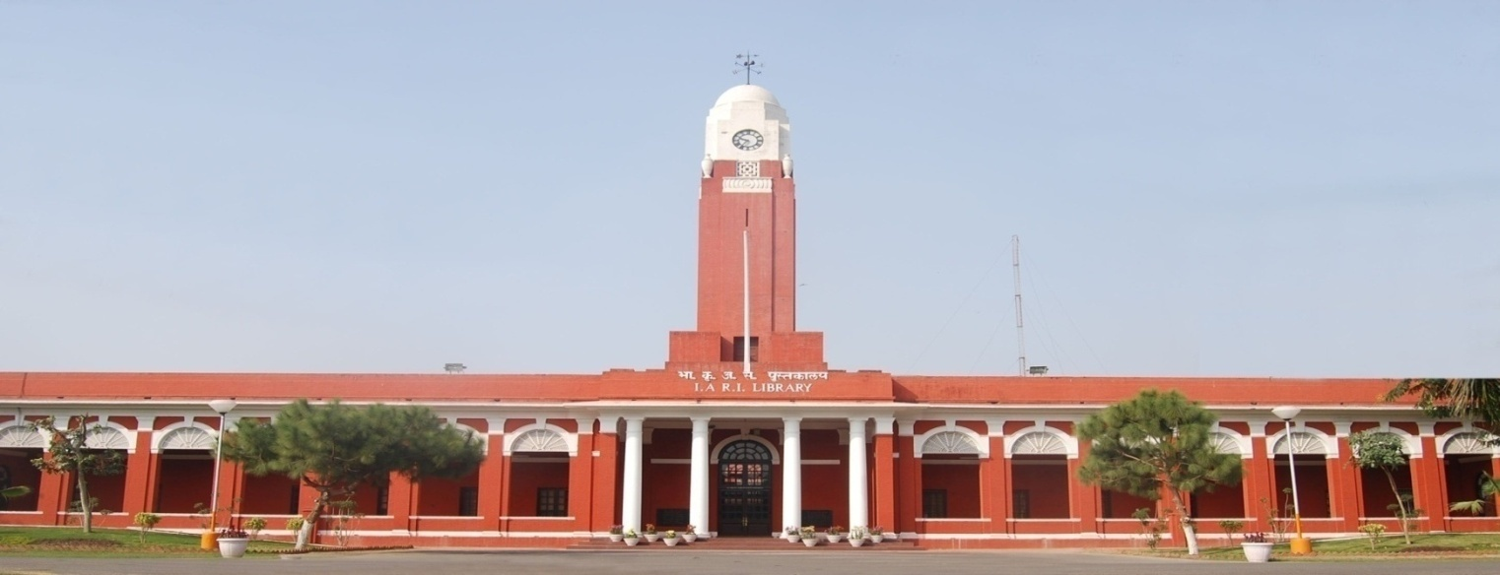
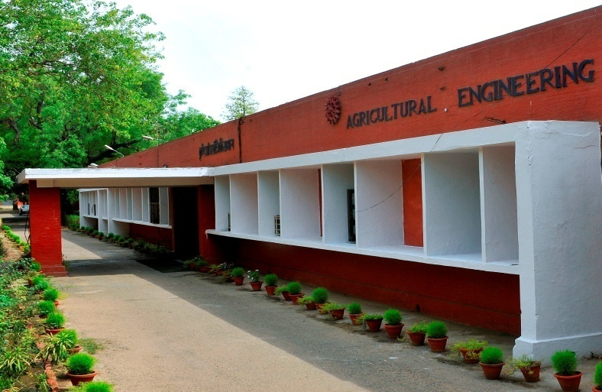
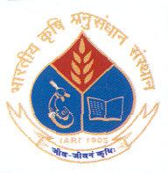
Drone Assisted Spraying : Challenges and Way Forward
Prof. Indra Mani
(E-mail : maniindra99@gmail.com; head_engg@iari.res.in)
Joint Director Research (ICAR-IARI)

Slide 2
Drone as a future technologies for agriculture

Slide 3
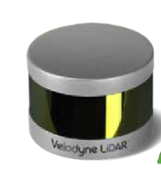
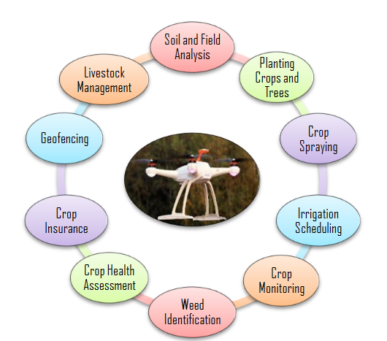
Drone applications in Agriculture
With the availability of sensors, drones can detect the things which are beyond the visible range of human sight.
Real-time, more accurate, reliable, and objective information can be derived from drones in greater detail and fewer errors.

Slide 4
Standard guidelines for operation of drones for pesticide application
In a DoAC&FW–ICAR Interface held on 18.04.2019, a decision was taken to entrust responsibility to ICAR to study the use of drones and recommend standard guidelines for operation of drone for pesticide application.
In view of the above, a committee was constituted under the chairmanship of Dr. K. Alagusundaram, DDG (Agril. Engg.) ICAR by Department of Agriculture, Cooperation & Farmers Welfare (M& T Division) , Ministry of Agriculture & Farmers Welfare, Government of India vide letter No. 13-8/2017-M&T(I&P) dated 27/05/2019) to formulate the standard guidelines for operation of drones for pesticide application.
Terms of Reference of the Committee
To develop guidelines for operation of drones in application of spraying of pesticides, growth hormones, fertilizers in different crops at different stages with the following terms of reference:
Challenges in drone use for pesticide application
Advantages of drone use in pesticide application
Current status & future prospects of drone use for pesticide application
Drone laws & regulations to be followed
Affordable & sustainable solutions to use drones for pesticide application
Different standards in terms of : Pre-requisites to use drones, minimum area, climatic conditions viz; temp, wind speed, height of application, droplet size etc; to be followed in use of drones to offset drift, air pollution
Economic analysis
Final recommendations

Slide 5
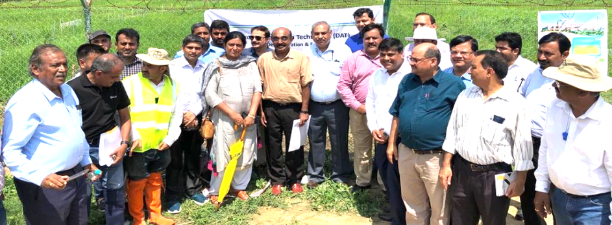
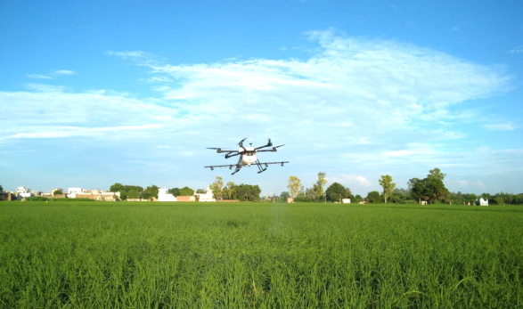
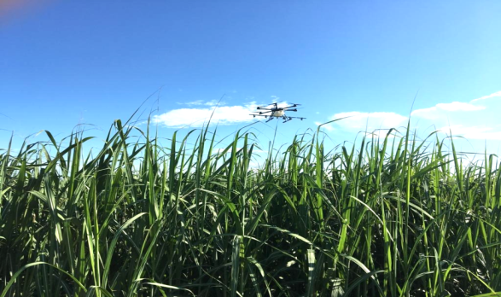
Standard guidelines for operation of drone for pesticide application
Government officials, researchers, industry and stakeholders team was formulated to finalize the guidelines.
Suggestions were made for trials for better understanding of various parameters affecting pesticide efficacy when applied through drones.
The demonstration and experiments were conducted in Karnal, Haryana and IARI field, New Delhi
The experiments were conducted on paddy, sugarcane and pear crops.
The co-opted industry representatives were engaged in the field evaluation process.
Drone based pesticide applicators and other accessories were arranged with the help of industry representatives (Bayer Crop Science Ltd. and IoTech Word Avigation Pvt. Ltd).

Slide 6
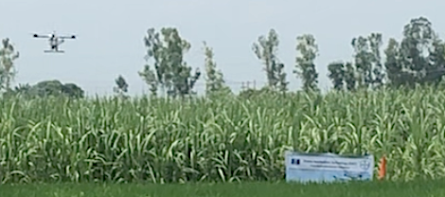
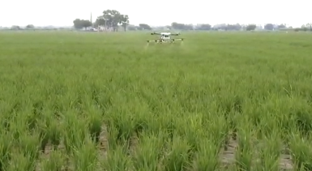
Field evaluation at Karnal, Haryana
The drone was operated in two field crops i.e. sugarcane and paddy and one orchard of pear in the Tarawadi area of Haryana.
For drone pilot evaluation, a paddy field of 20mx16m was chosen in which assessment was done on a 10mx10m area using water sensitive paper.
For monitoring of penetration and uniformity of spray, water sensitive paper was fixed at three different positions along the height of plant in paddy and sugarcane.
Another plot of size 20mx16m was selected for evaluation purpose using chart paper and dye to check distribution pattern.
Vertically as well as horizontally across the crop field, uniformity spray pattern was observed through visual observations.
A number of farmers participated in drone demonstration pragramme and gave their feedback and suggestions.
SUGARCANE
PADDY
PEAR

Slide 7
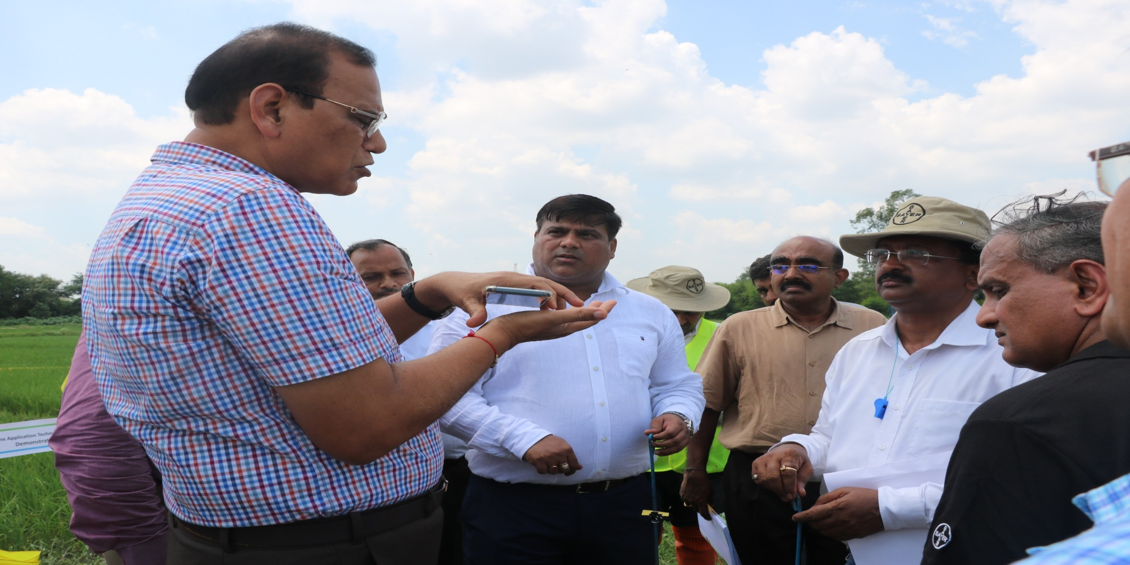
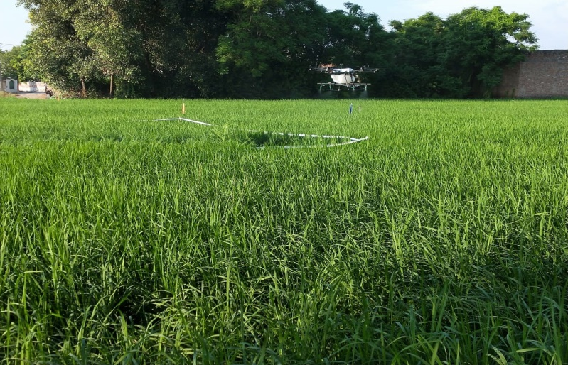
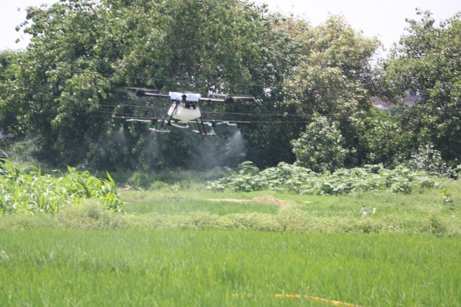
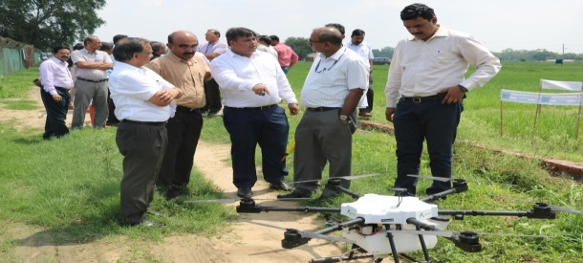
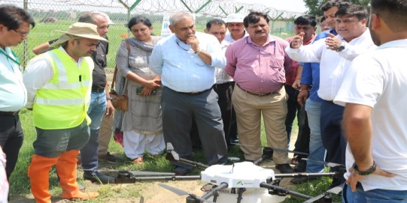
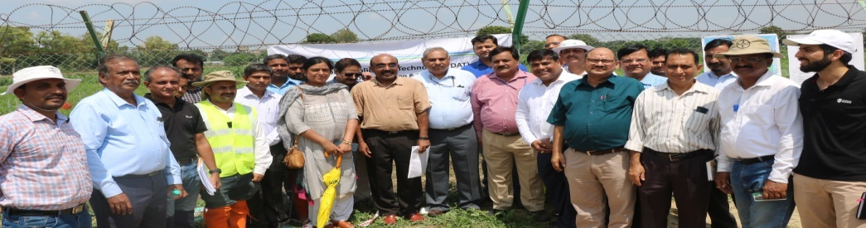
Drone for pesticide application (Standard guidelines for safe operation)

Slide 8
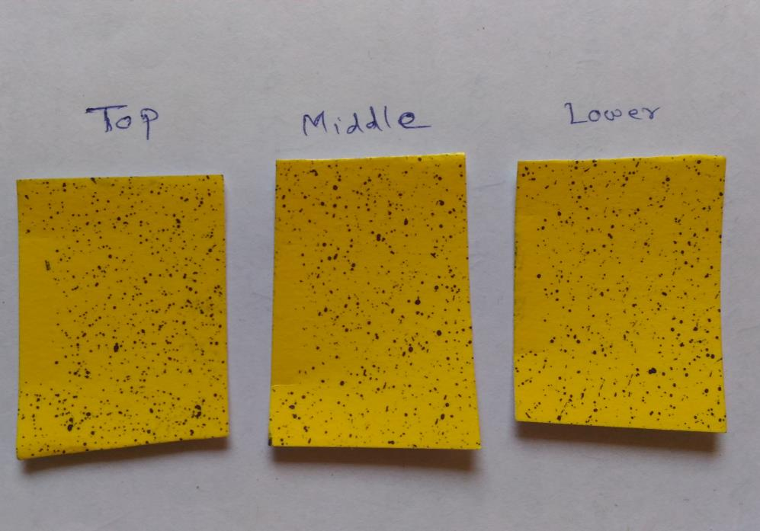
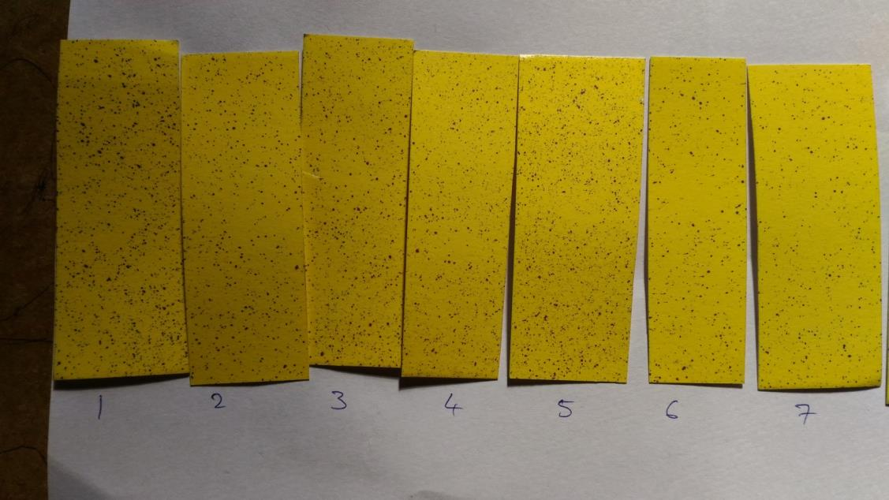
The main advantage of drone application over backpack spray application is the uniformity of spray vertically (from top leaf to lower leaf) as well as horizontally (across canopy). This uniformity is mainly achieved by the Downwash effect caused by the Rotors of the drones and can have advantages over traditional spraying especially in case of diseases or pests hiding in the lower part of the plant as in the case of Rice Hoppers or Paddy Sheath Blight.
Observations
Top
Middle
Lower
Uniform Coverage through the height of the plant
Uniform Coverage across the spread of the plant

Slide 9
Challenges and Way forward : Pesticide and Crop Nutrient application
Challenges | Way forward
High initial cost of drone (Affordability issue) | Custom hiring use of drone Drone under SMAM scheme providing 100% subsidy to ICAR Institutes and SAU's , and 75% to FPOs
Drone compatible pesticides and crop nutrients | CIB&RC gave interim approval to 477 pesticide formulations for application through drones.
Adoptability by farmers | Large scale demonstration at farmers field (Seeing is Believing) Policy support under SMAM upto Rs. 6000 per hectare for demonstration on farmer’s field
Significant influence of sprayer parameters, flight parameters, and environmental factors on droplet deposition level in target crops | Scientific study To generate data on effect of different design and operational parameters on spray quality and bio-efficacy with UAV assisted spraying optimization of parameters for spray quality and efficacy with drone assisted spraying in major crops under different agro-climatic zones

Slide 10
Challenges and Way forward : Pesticide and Crop Nutrient application
Challenges | Way forward
Lack of skills related to drone operation and handling | Training programs through ASCI, DGCA and Indira Gandhi Rashtriya Uran Akademi related to operation, handling and maintenance of Kisan drones
Limited use hours of drone | Need for research on multiple use of drone such as Sensor based soil and crop health monitoring, pollination, seed sowing, irrigation etc. Development of Variable Rate Technologies VRTs (NePPA project ICARI-IARI)
Availability of Agriculture drones | Promotion of drone manufacturing under Make in India Program and Subsidy on agriculture drone
Establishment of Centre of Excellence on Kisan Drones in ICAR Institutes, SAU’s and CAU’s

Slide 11
Thank You

