Slide 1

Research, Education and Capacity Building: Application of drones for agriculture
MPKV-CAAST Initiatives
National Conference on
Promotion of Kisan Drones- Issues, Challenges and Way Forward
2 May 2022
Department of Agriculture & Farmers Welfare
Ministry of Agriculture & Farmers Welfare
Govt. of India
Dr. Sunil D. Gorantiwar
Head (Agril. Engg.) and Principal Investigator (CAAST-CSAWM)
Mahatma Phule Krishi Vidyapeeth, Rahuri

Slide 2
Drone Laboratory
S. N. | Drones | Quantity
1 | Hyper-spectral imaging drone | 1
2 | Fixed wing (VTOL) drone | 1
3 | Mapping drone with thermal and 3D LiDAR | 1
4 | Mapping drone with RGB | 2
5 | Spraying drones | 3
6 | Spraying and spreading drones | 3
7 | Training grade drones | 2
8 | Practical assembly drones | 24
Total, count |  | 37

Slide 3
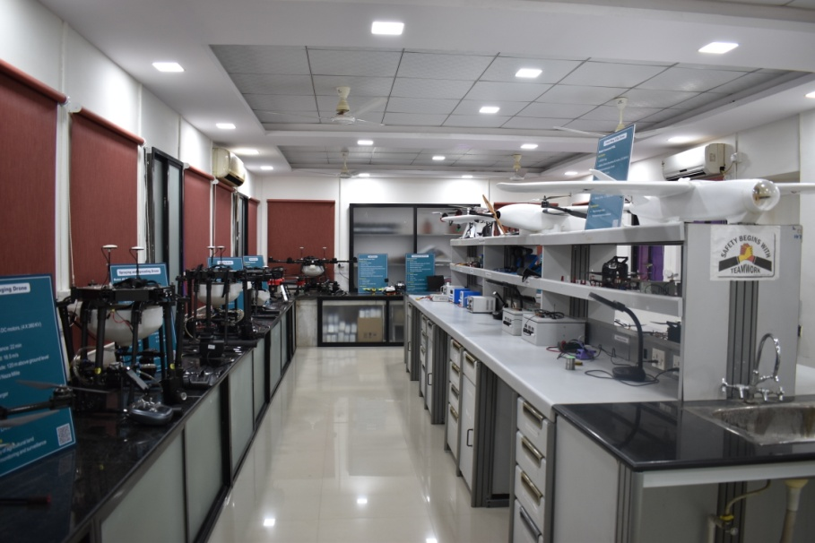
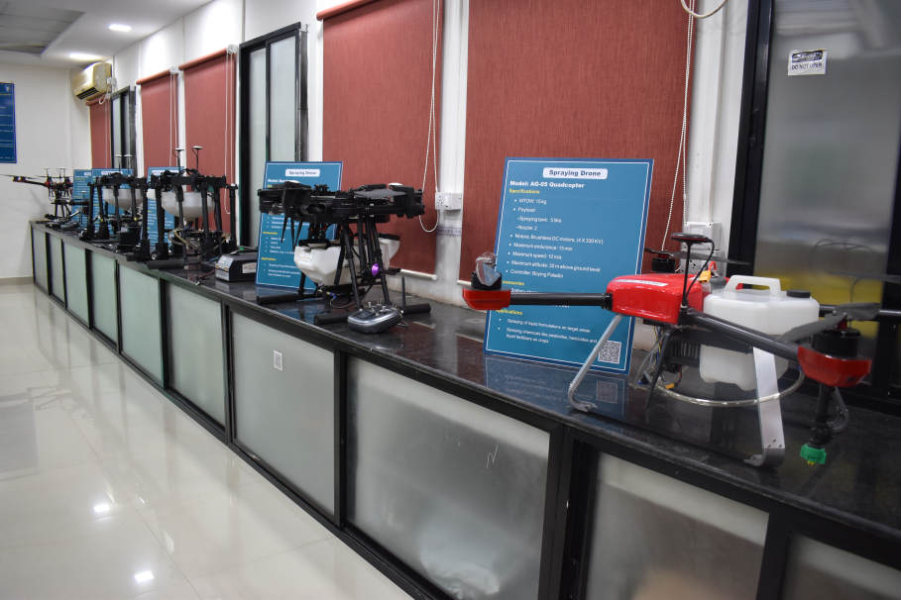
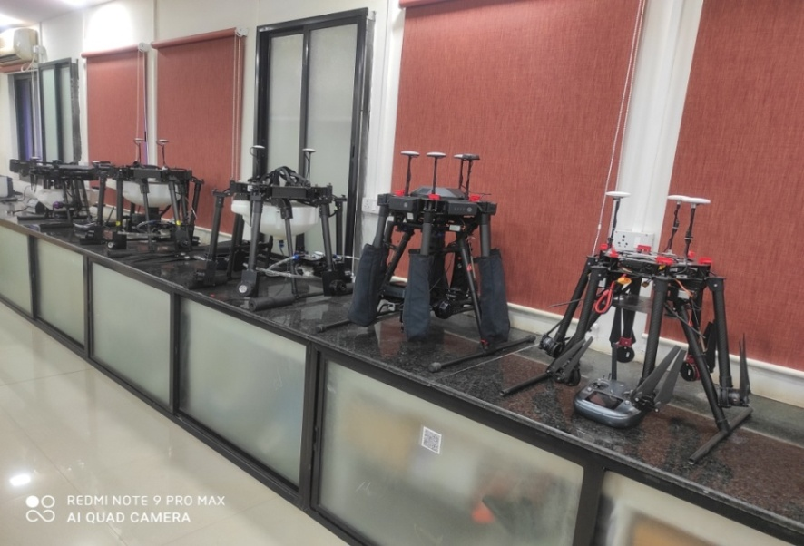
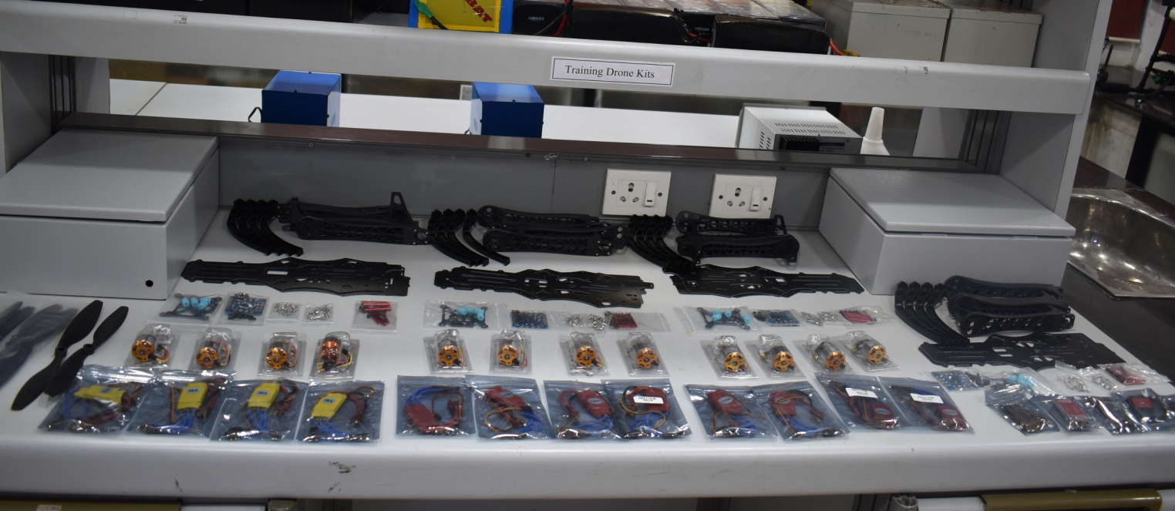
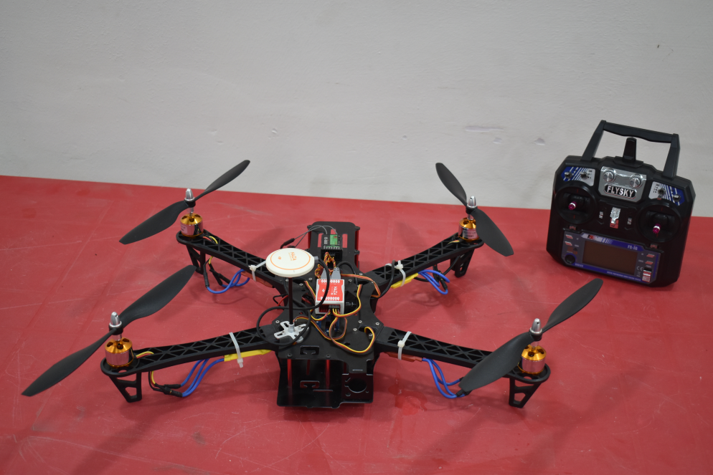
Drones Research Laboratory

Slide 4
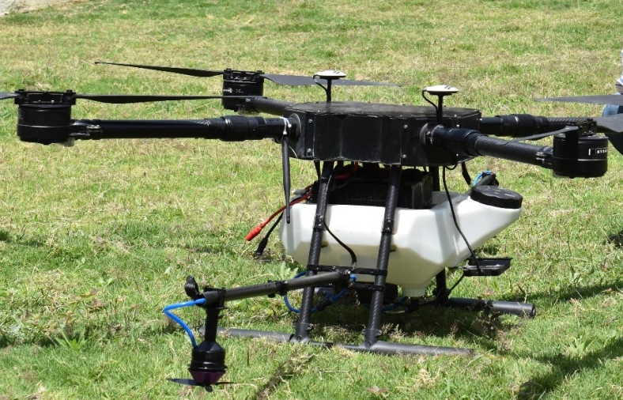
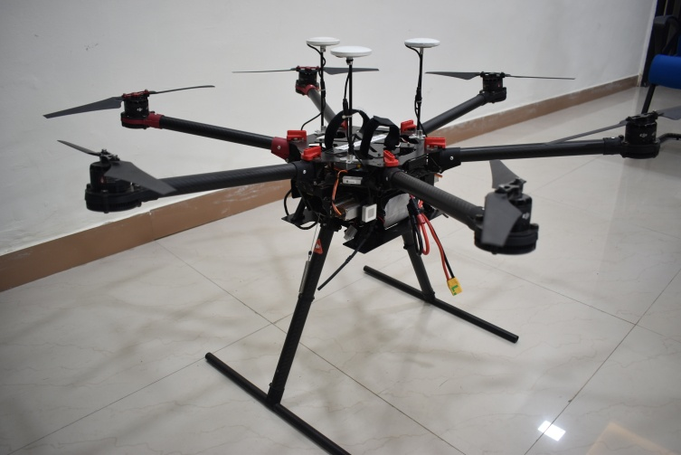
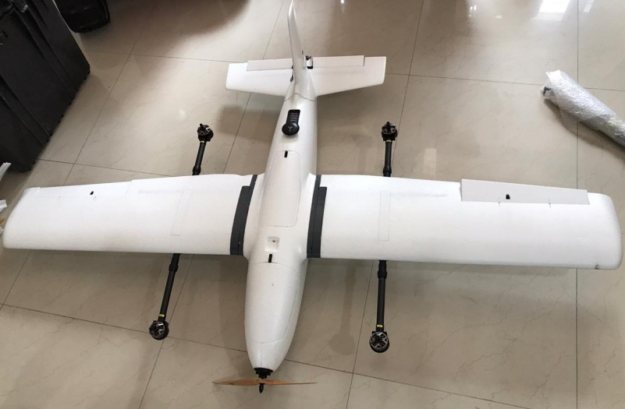
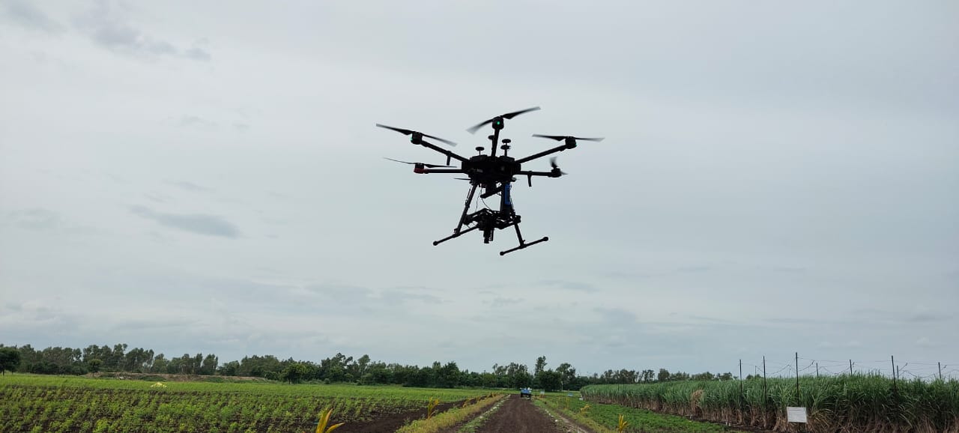
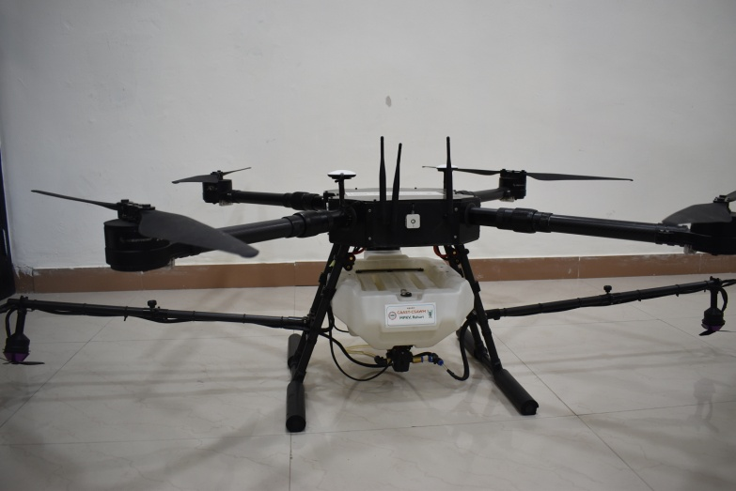
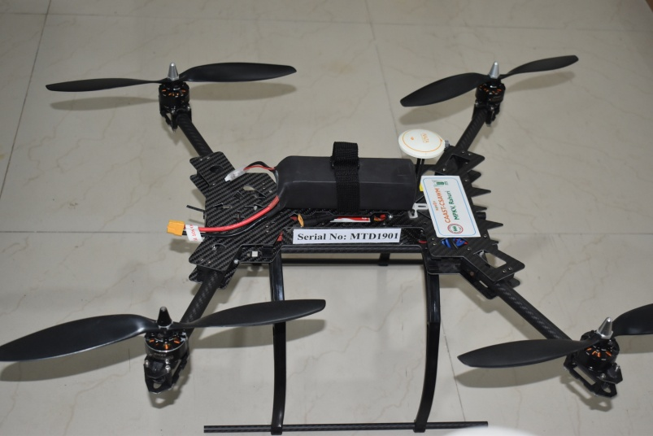
Spraying drone
Mapping drone with thermal and 3D LiDAR
Fixed wing (VITOL) mapping drone with RGB
Hyper-spectral imaging drone
Spraying and spreading drone
Training drone

Slide 5
DGCA approved RPAS training at Redbird Aviation, Baramati
Five members from the university successfully completed RPAS pilot training course.
Third batch from Redbird Aviation.
First batch from Agricultural based Institutes.
First FIFTY RPAS Pilots
One Faculty
One Technical staff
One PhD student
Two Research Associates

Slide 6
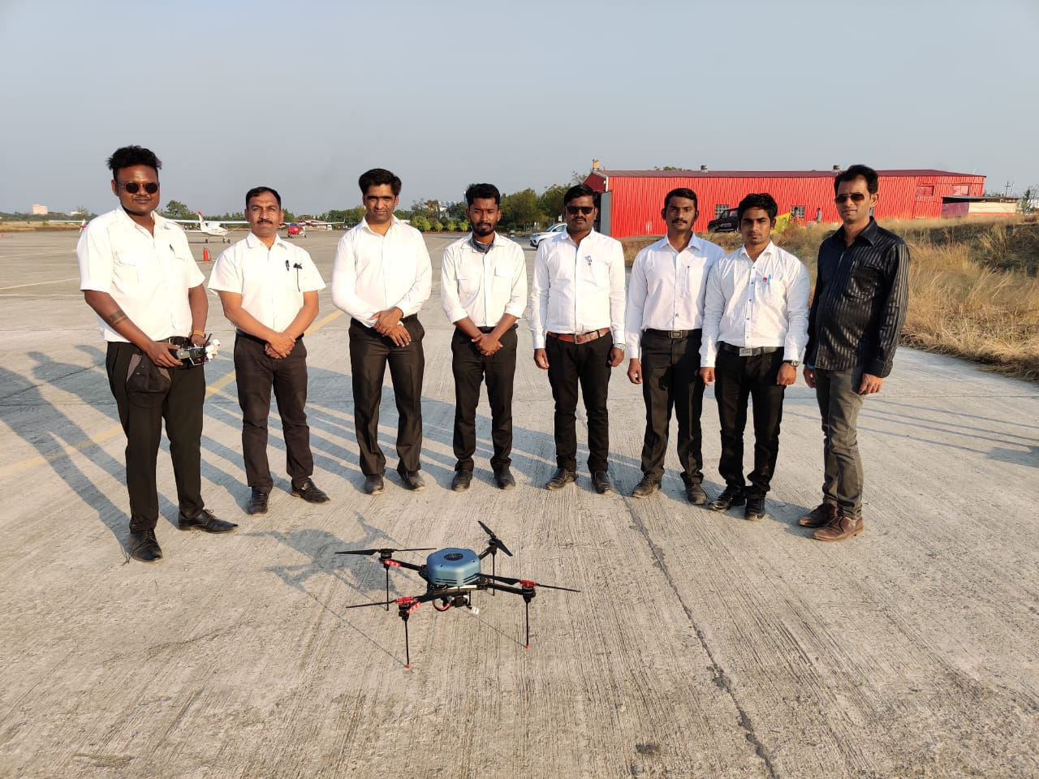
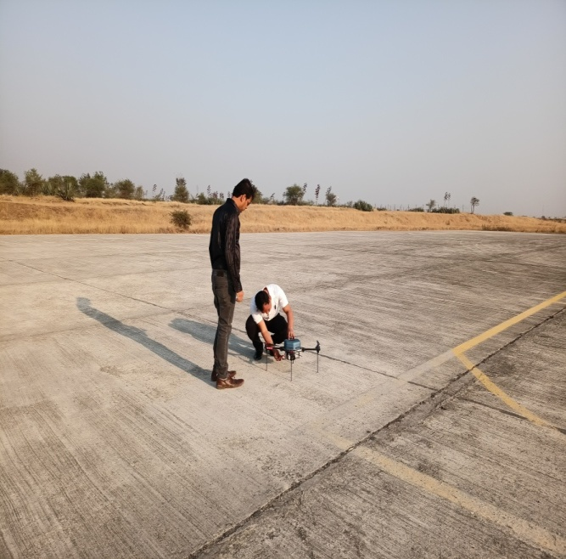
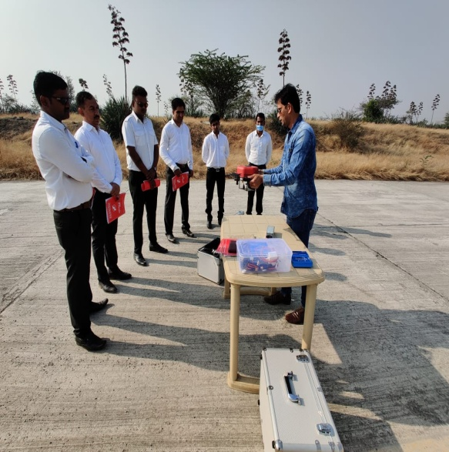
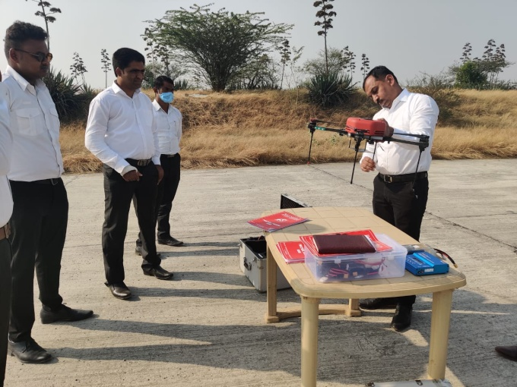
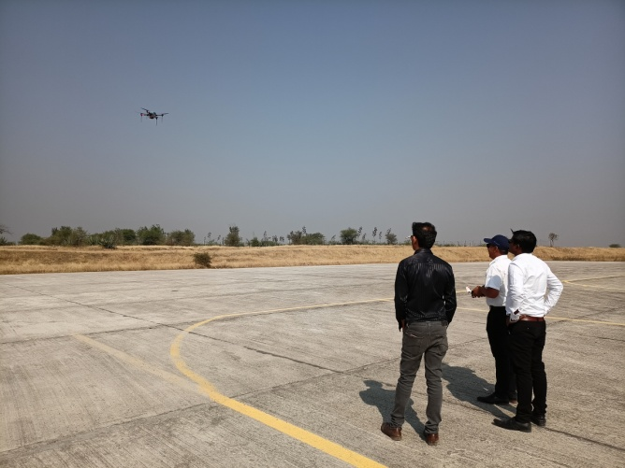
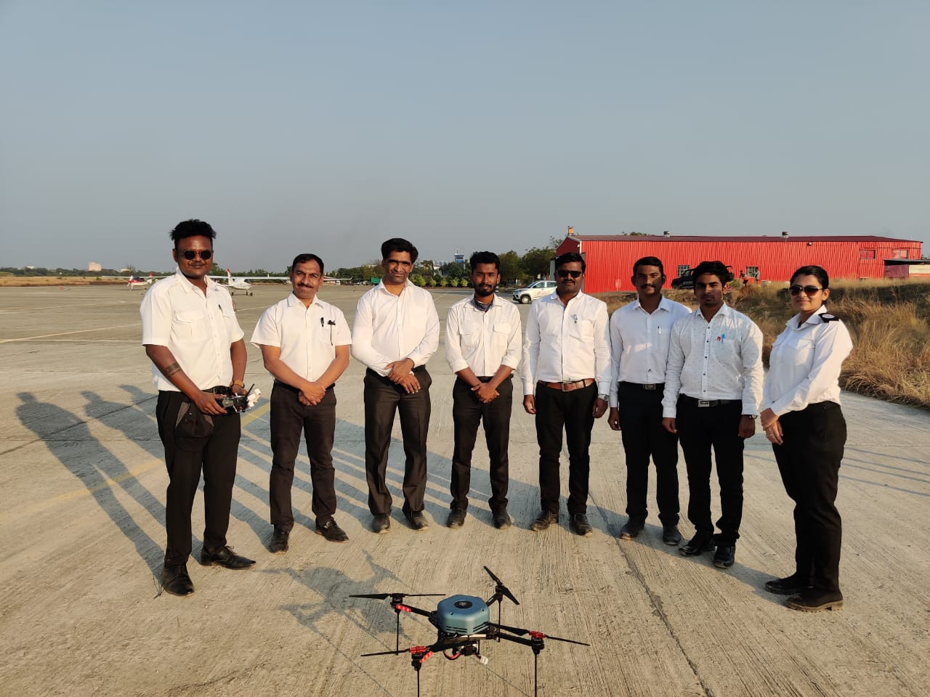
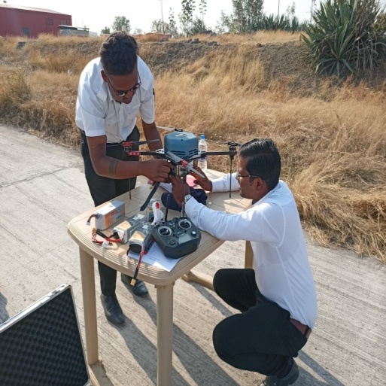
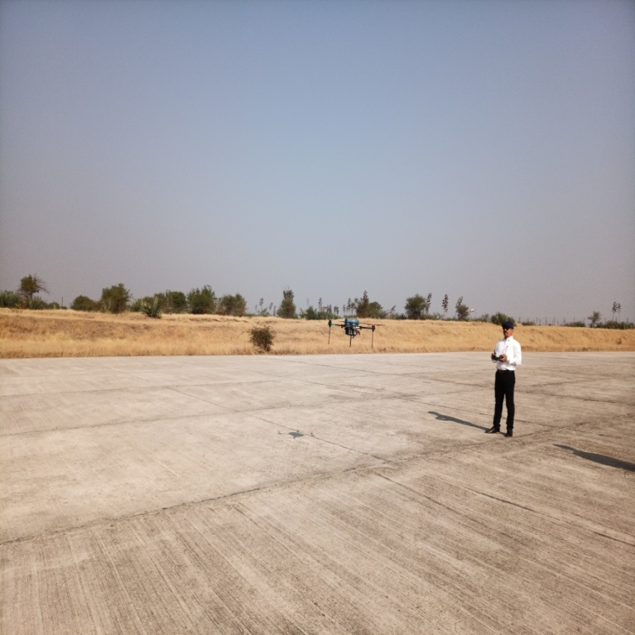
Glimse of training programme

Slide 7
SoP for drone spraying of chemicals and crop nutrients
Dr. Sunil D. Gorantiwar, Head, Agricultural Engineering was member of committee
Dr. Sachin Nalawade, Head, FPME and
Dr. Girish Bhanage, RA, CAAST-CSAWM contributed to SoP

Slide 8
Dissemination of UAV Technologies
S. N. | Title | Duration | Participants
1 | Student- Industry Interface on Application of drone technology in Agriculture | 28 March 2019 | 221
2 | Training on Basics of Drones, AI and Geo-informatics for CSA & WM | 18 Sept - 01 Oct, 2019 | 25
3 | International Scientist-Students Interface on Drones Robotics AI and FM | 11-12 January 2020 | 375
4 | Application of Drone in agriculture | 11-12 Feb, 2020 | 31
5 | Fundamental of UAV for Precision agriculture | 25-30 April 2020 | 623
6 | Hands on Training programme on “Operation of UAVs for Precision Agriculture” | 3-5 March 2021 | 9
7 | Certificate course on “ Fundamentals of UAV” | 15 March-4 April 2021 | 102
8 | Demonstration of Spraying drone for application of Nano Urea on farmers field | 16 February 2022 | 85
9 | Demonstration of Spraying drone for application pesticide on farmers field | 18 February 2022 | 23
10 | Demonstration of spraying drone on farmers field for application nutrients | 25 February 2022 | 127

Slide 9
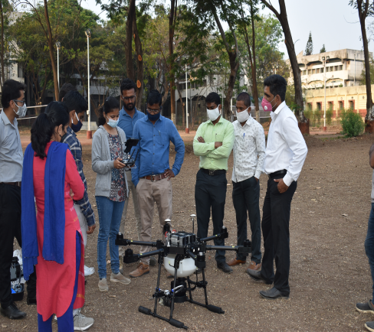
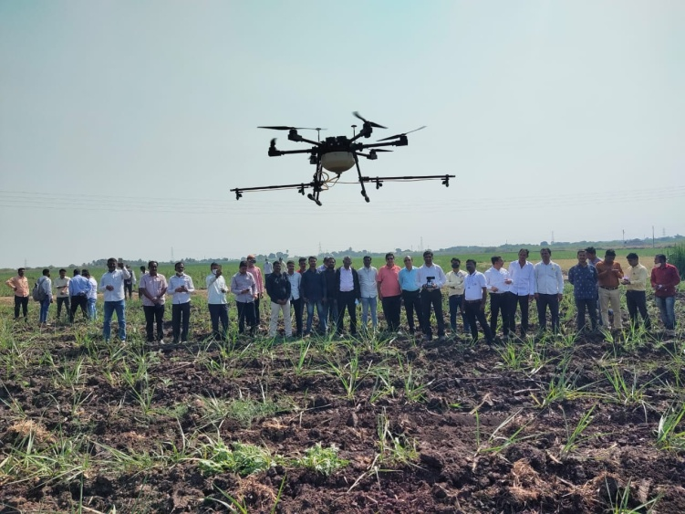
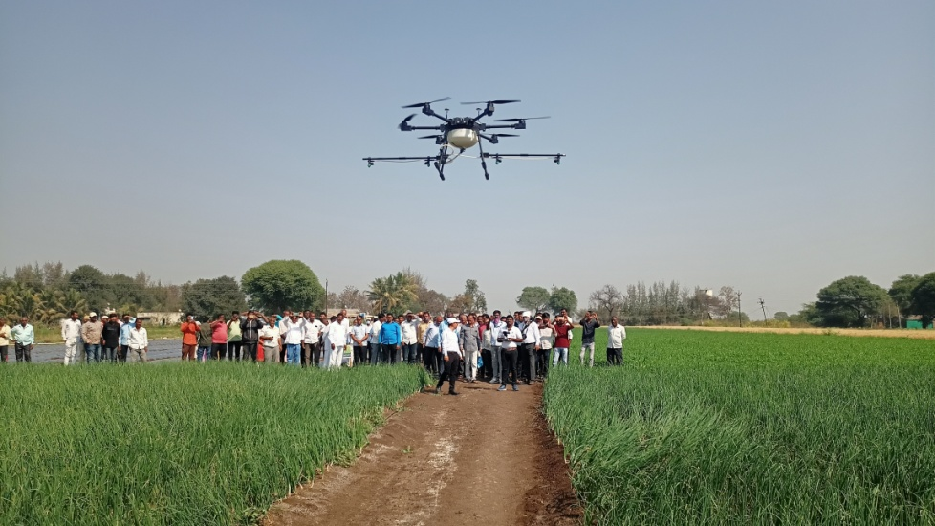
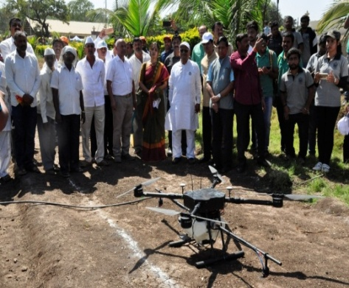
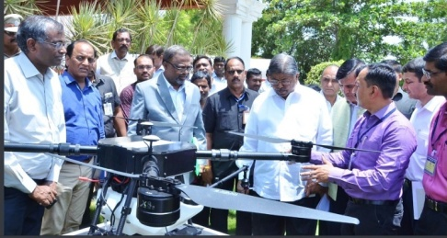
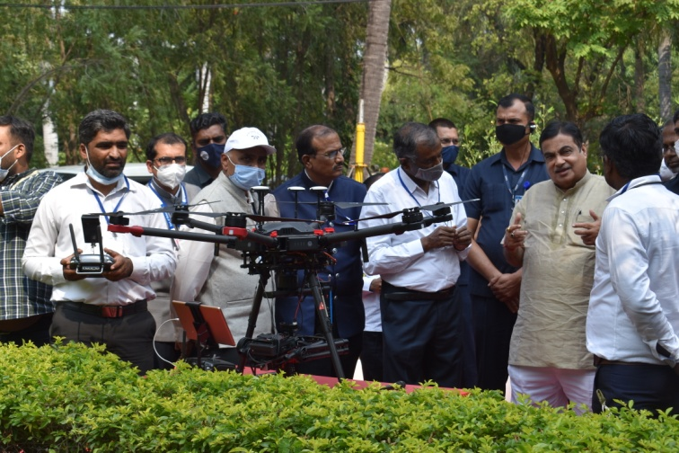
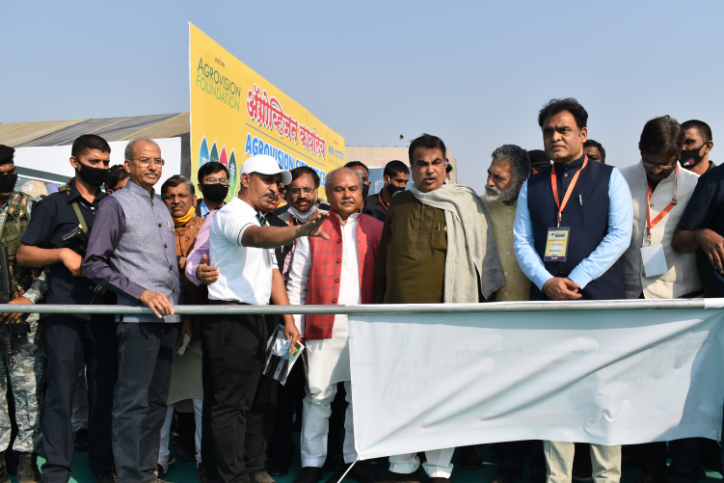
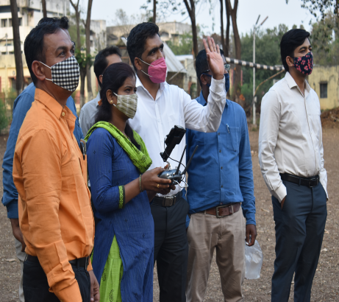
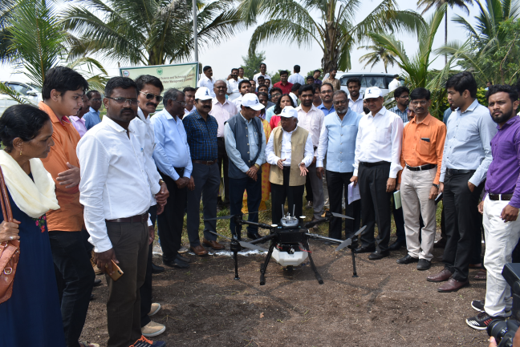
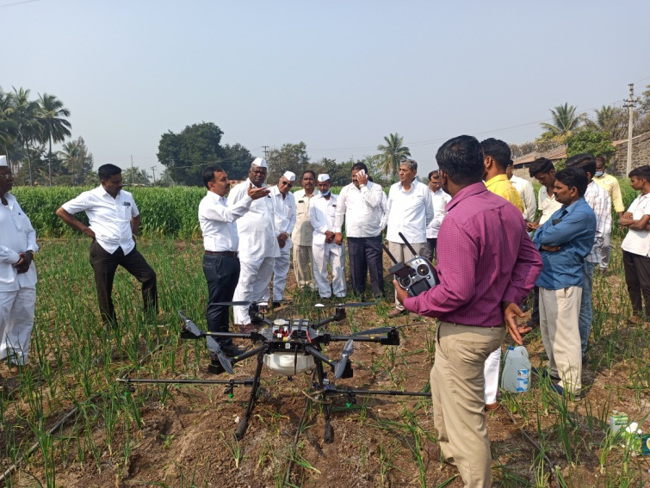
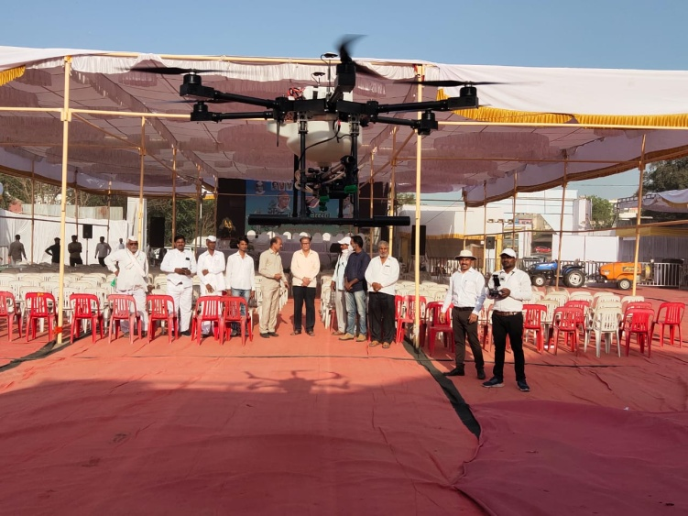
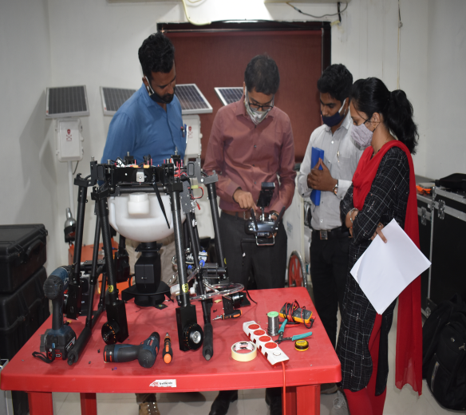
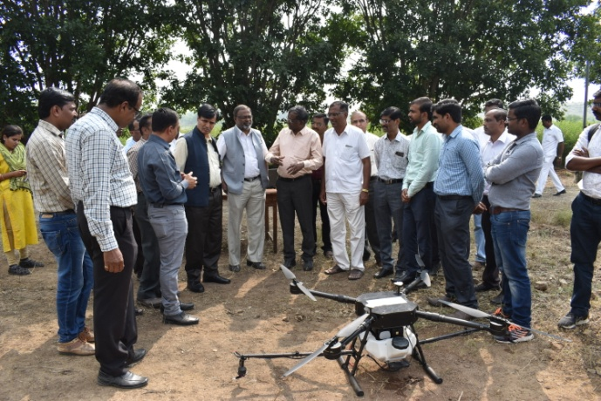
Dissemination of UAV Technologies

Slide 10
Establishment of Remote pilot training organization
Remote pilot training organisation is DGCA approved training center for drones training as to fly drones in India RPAS licence is mandatory by DGCA. To obtain RPAS Licence only DGCA approved RPTO can issue the licence
Benefits of RPTO
Development of trained manpower to use of drones for agriculture applications.
Creation of green zones for flying drones
Very few organisations have RPTO in India, none is specialized on agricultural drones
RPTO helps for organisation of training programme for students and faculties to develop their capacity in this field.
Establishment of INCUBATION CENTRE

Slide 11
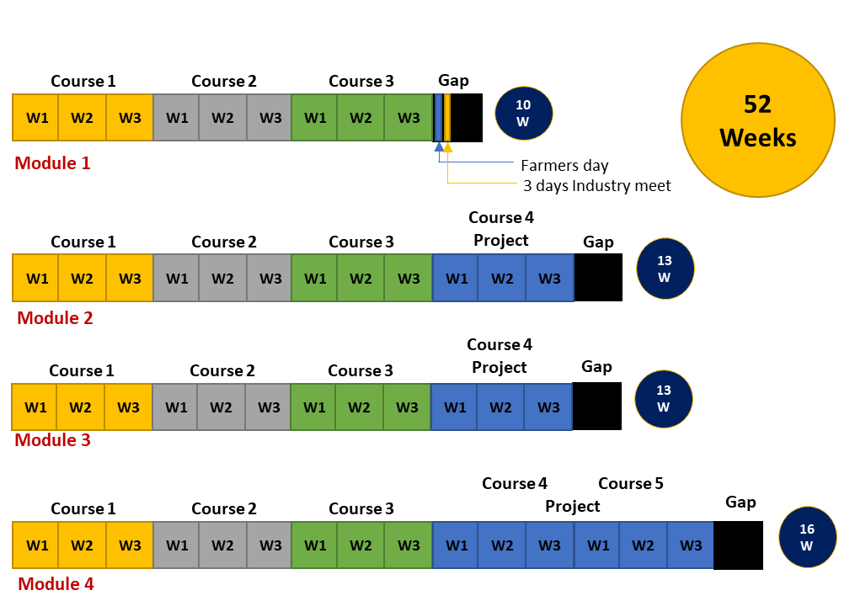
Post Graduate Diploma module outline
Specialization: Depending on the courses completed by the student, the specialization will be offered as below,
Climate Smart Agriculture - Geoinformatics (GI)
Climate Smart Agriculture – Natural Resources Management (NRM)
Climate Smart Agriculture – Robotics, Drones, IoT & Precision Farm Machineries (RDI)
Climate Smart Agriculture – Precision Water Management (PWM)
Climate Smart Agriculture – Social Science (SS)

Slide 12
Ongoing research on Drone
Sr. No. | Research project
1 | Optimization of operating parameters of spraying with drone (UAV) for sugarcane
2 | Drone spraying mechanism for small farms
3 | Monitoring growth and yield estimation of Soybean using UAV based hyperspectral imaging sensors
4 | Comparative evaluation of organic fertilizer formulations application on soybean using drones sprayer
5 | Prediction of yield of rabi Sorghum using UAV based hyperspectral imaging sensors

Slide 14
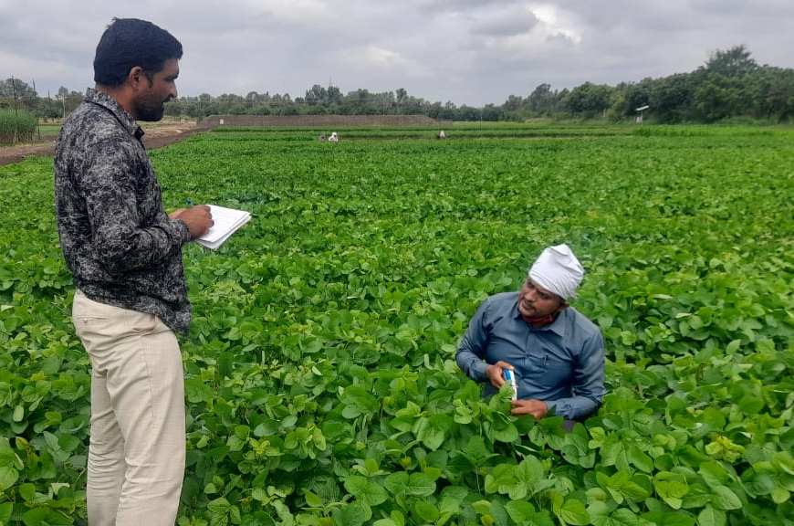
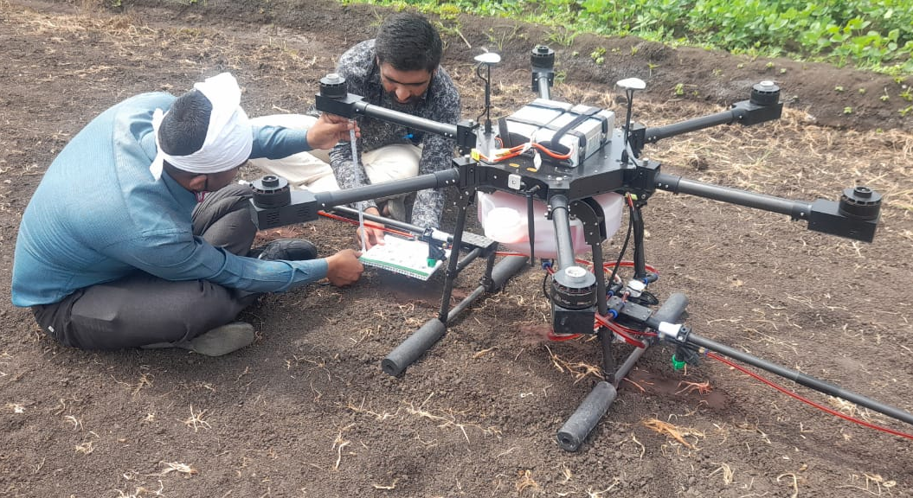
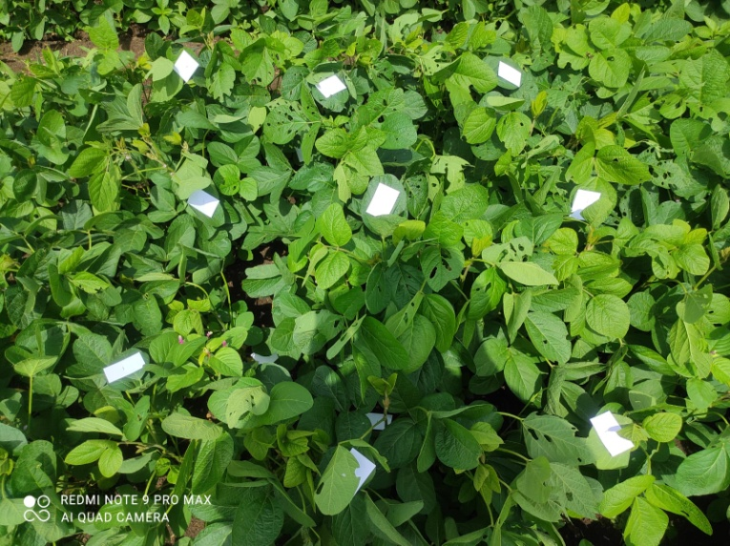
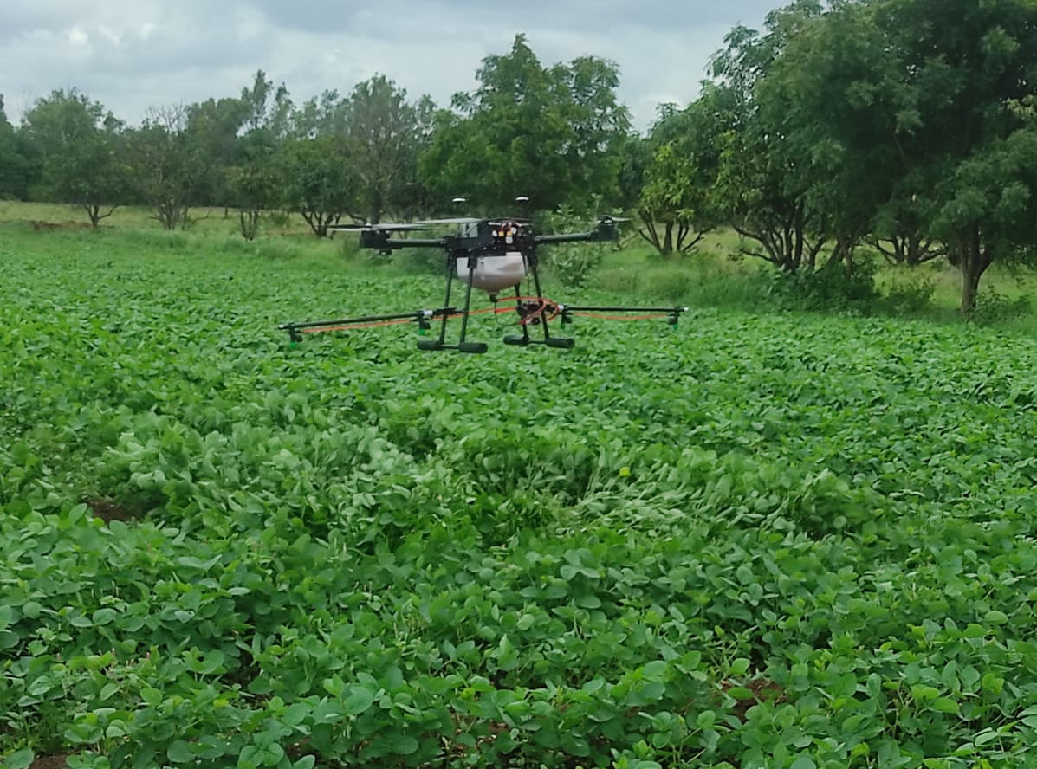
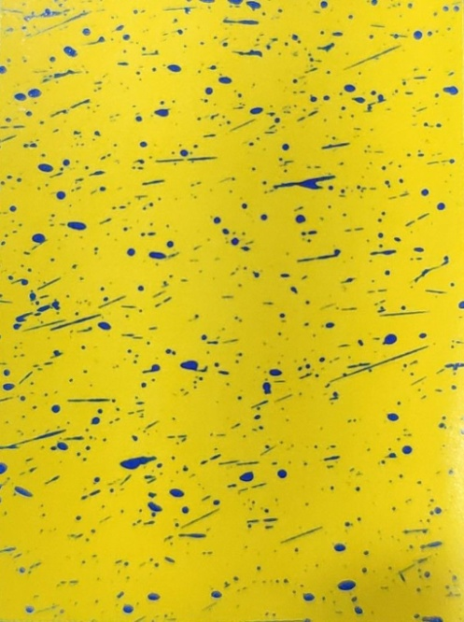
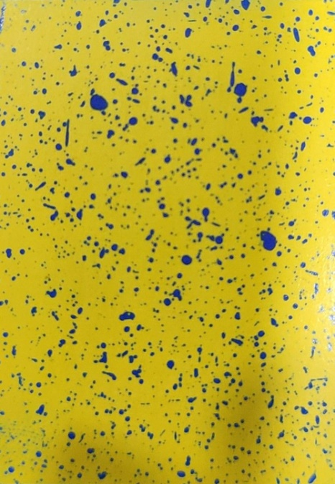
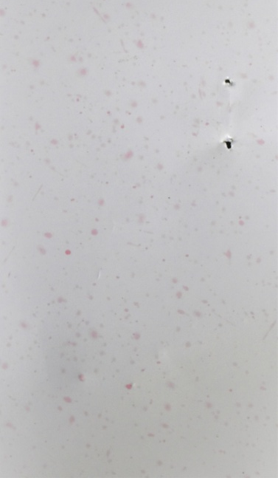
Measurement of cop canopy
Measurement of actual nozzle height from Radar sensor
Glossy paper on crop canopy
Glossy paper
Water Sensitive Paper
Spraying on soybean
Spray uniformity

Slide 15
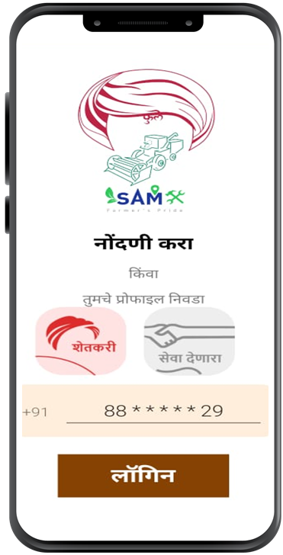
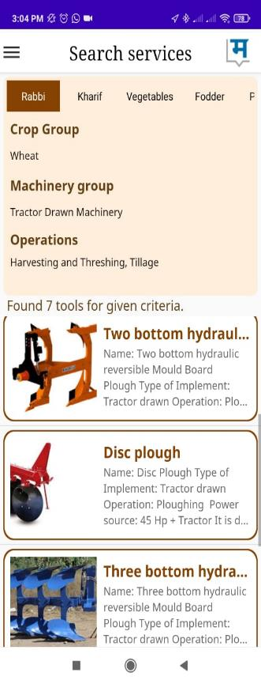
Services for Agricultural Mechanization (“Phule SAM”)- useful for custom hiring
Phule SAM is a mobile application which is developed with the view that farmers will benefit from the readily available services and quality work at a reasonable cost for their agricultural machineries.

Slide 16
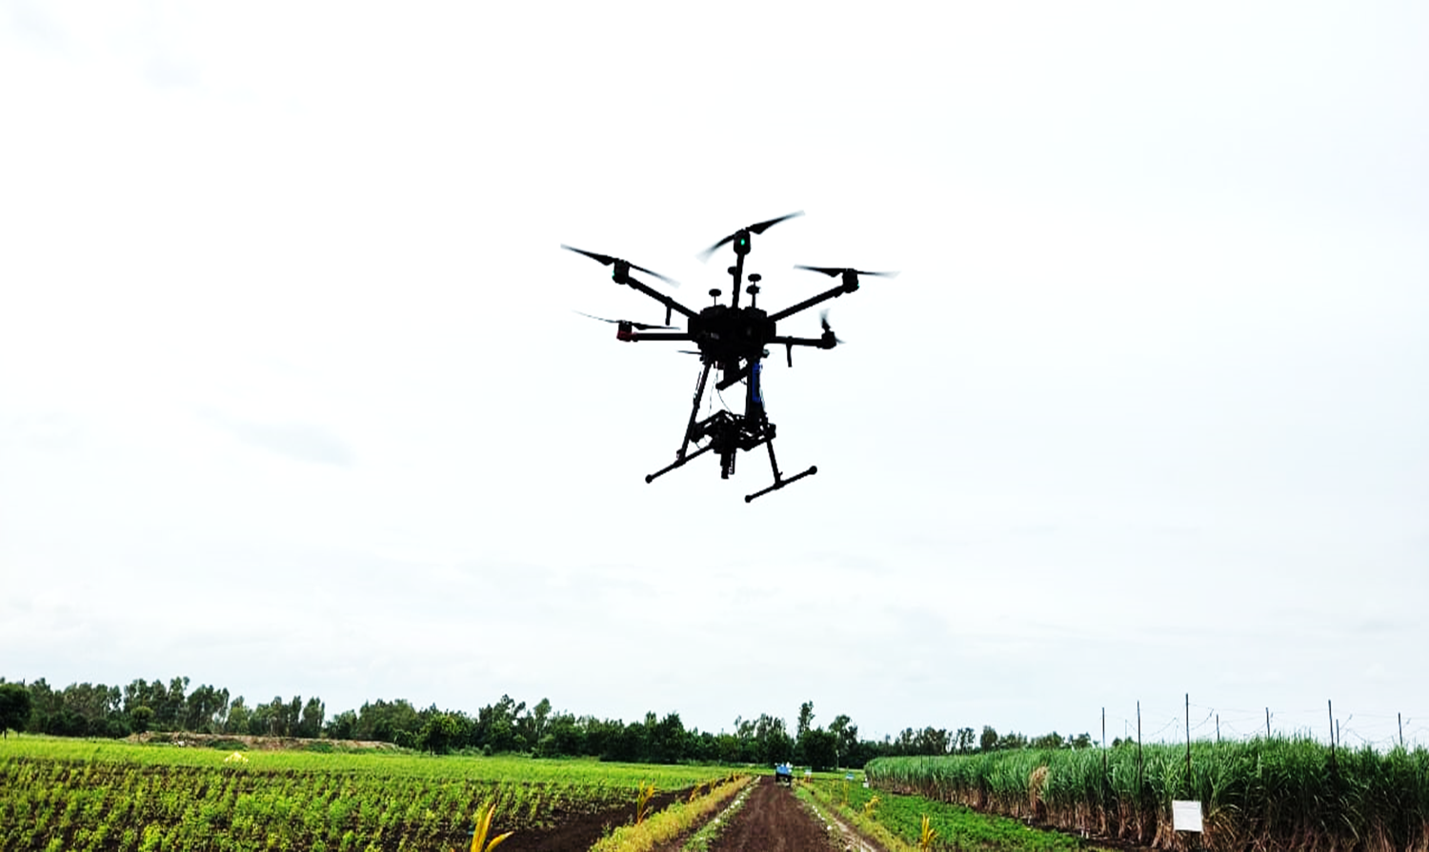
Some issues/challenges with drone applications in agriculture
–
Certified formulations-chemicals and nutrients
Flight time & range
Connectivity (interruptions)
Life cycle of battery
Performance weather dependent and weather highly variable (Windy & rainy conditions restricts drone flying)
High initial cost
Agril. Drone training institutes- not available
Knowledge & skills (Requires specialized skills & knowledge)
Land holding, High tension electric line, trees
Legislative and regulatory issues- lack of knowledge to drone operators, dynamically changing, permissions etc
. • .

Slide 17
Drone applications
for precision agriculture

Slide 18
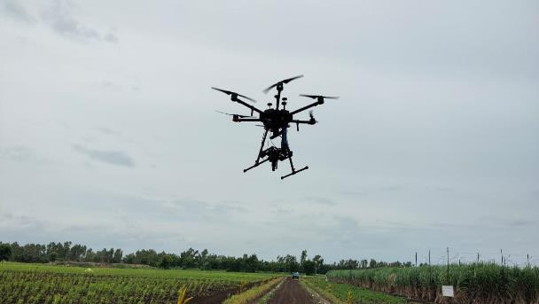
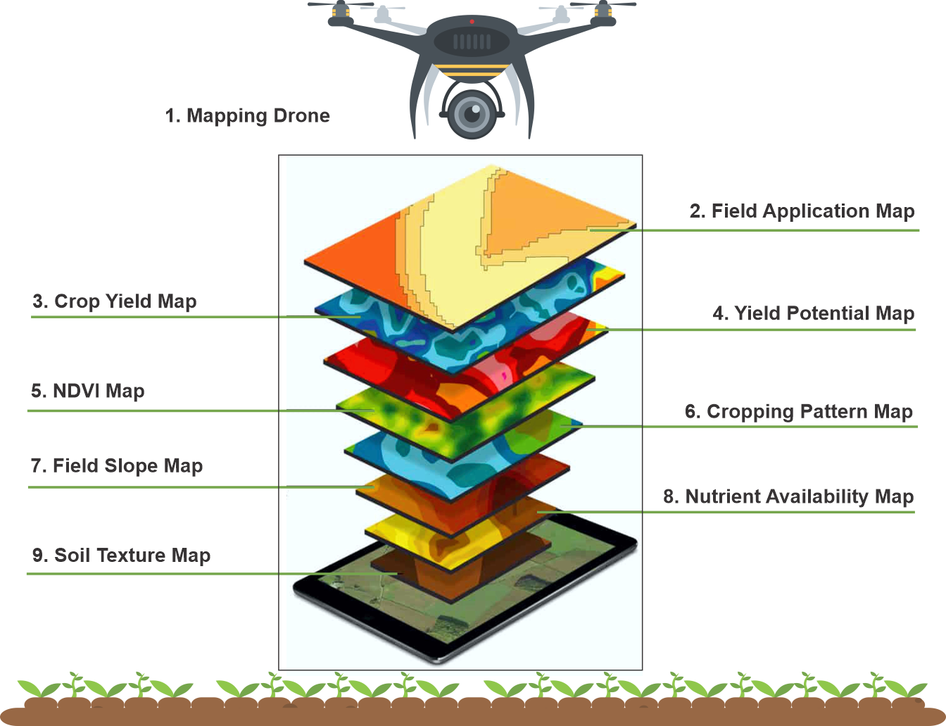
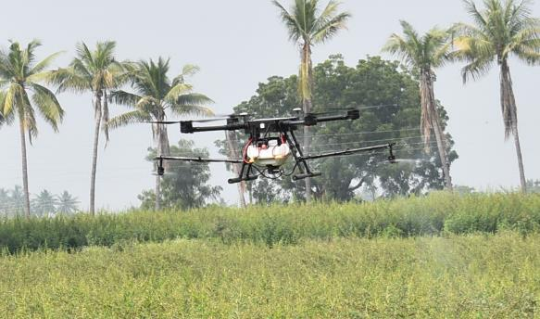
Mapping Drone
Collection of spectral signatures of different crops under different water stress conditions.
Optimisation of operating parameters of spraying drone. (Collaboration: Mahindra & Mahindra Ltd, Mumbai)

Slide 19
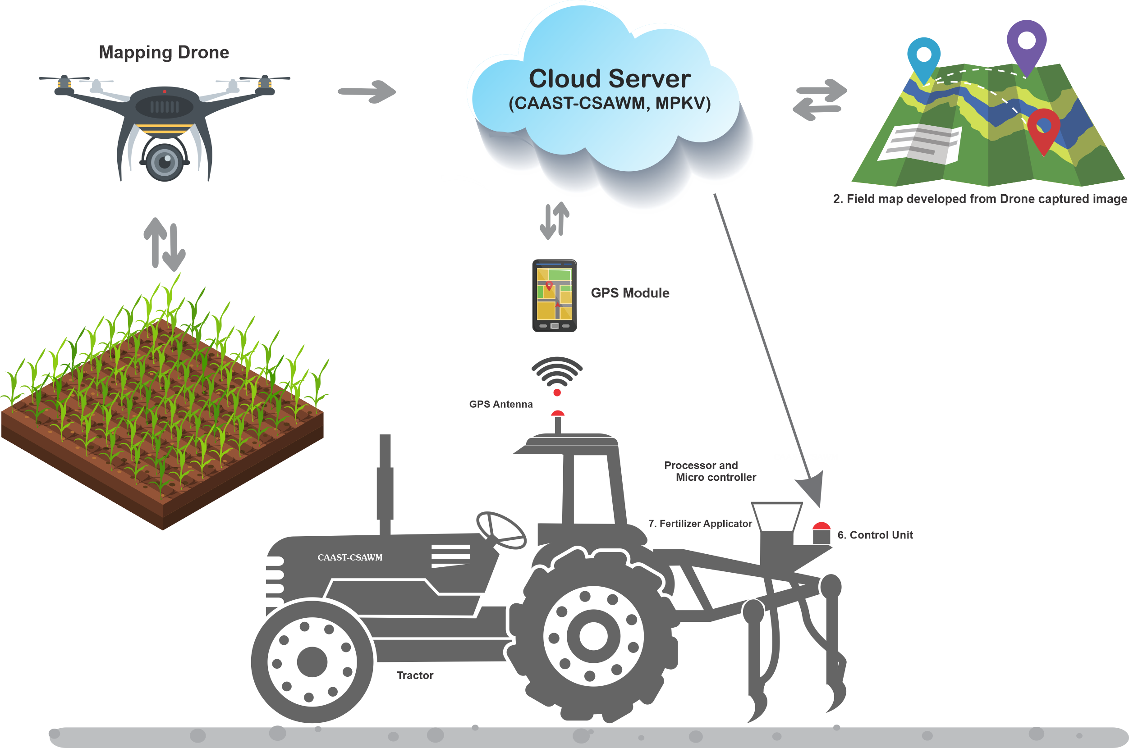
Real Time Variable Rate Nutrient Applicator

Slide 20
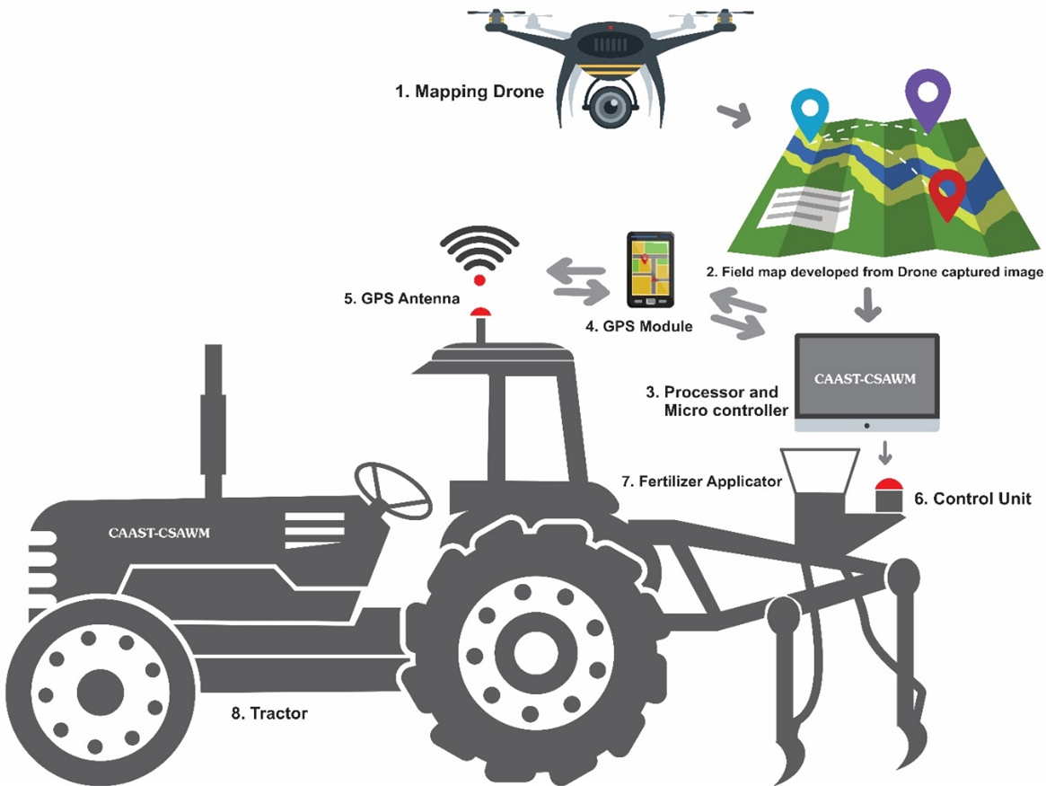
Real Time Variable Rate Nutrient Applicator

Slide 21
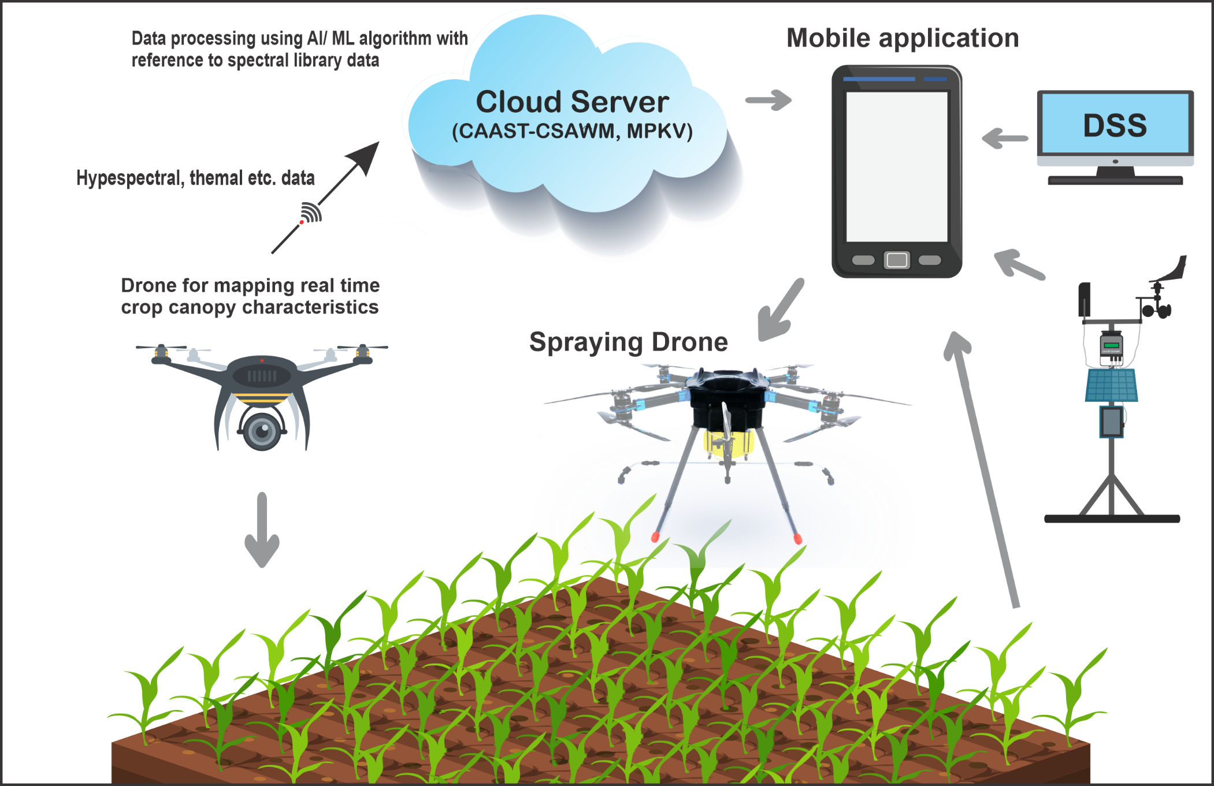
Intelligent Spraying Drone
Conceptualisation at CAAST-CSAWM (ICAR-NAHEP), MPKV, Rahuri

Slide 22
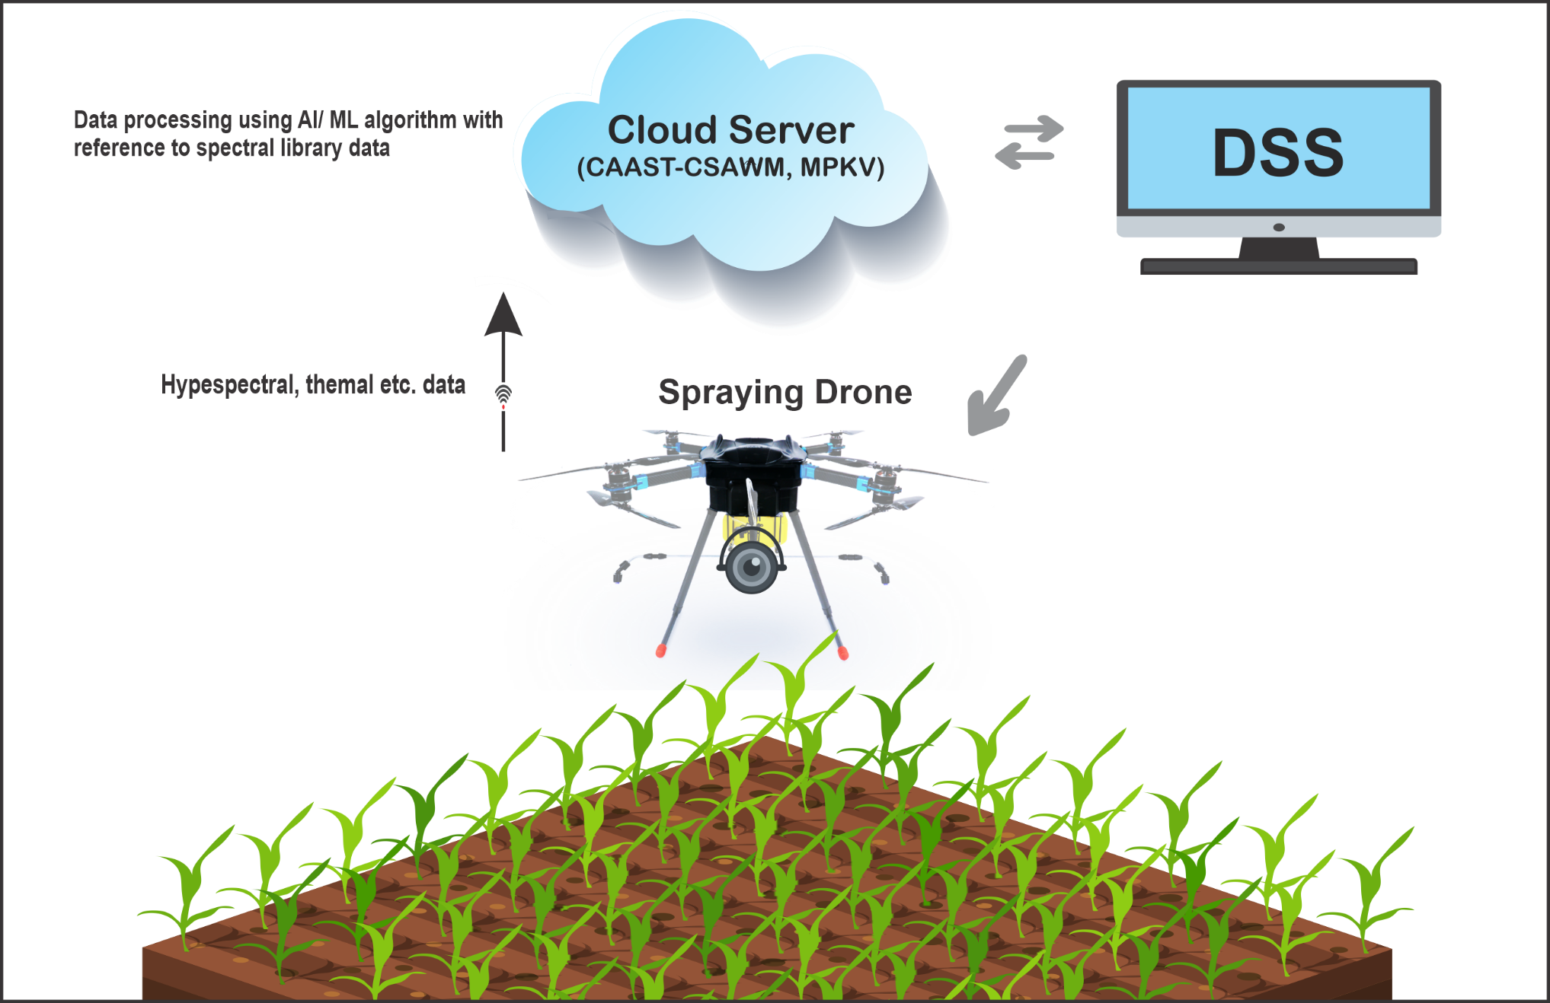
Intelligent Spraying Drone (Integrated)
Conceptualisation at CAAST-CSAWM (ICAR-NAHEP), MPKV, Rahuri

Slide 23

Soil Test Crop Response Based Fertilizer calculator

Slide 24

Drone based real time management system
Conceptualisation at RKVY-IWRAS, MPKV, Rahuri

Slide 25


Drone based real time management system
Conceptualisation At RKVY-IWRAS, MPKV, Rahuri

Slide 26





Drone based real time management system
Reflectance range
IR : 620-700 nm
NIR : 700-1300 nm
Reflectance range
IR : 620-700 nm
NIR : 700-1300 nm
NDVI
NDVI
Developed at:
RKVY-IWRAS Project, MPKV Rahuri
Conceptualisation at RKVY-IWRAS, MPKV, Rahuri

Slide 27
Benefits of Using Drones in Agriculture for spraying
–
No direct contact with spraying chemicals
Water saving (90% water saving with ultra-low volume spraying)
High field capacity & efficiency (20-40 ha per day)
Lower cost of spraying, easy to use and maintain
Wastage reduction (30% saving of pesticides)
Promote local entrepreneurship
Digital farming-Attractive farming
. • .

Slide 28
Drones: strengths
Drones can monitor any type of crop during its growing season, in any area.
Drones can collect raw data and translate it with algorithms into useful information
Drones can help farmers optimize the use of inputs such as seeds, fertilizers, water, and pesticides more efficiently.
Drones can act as an essential technology that will take farming to a completely new level
Drones can act as precision tool for farmers to optimize both farm productivity and profitability based on real-time field information thus protecting the environment, which can be turning point to success

Slide 29

Thank you very much

