Slide 1
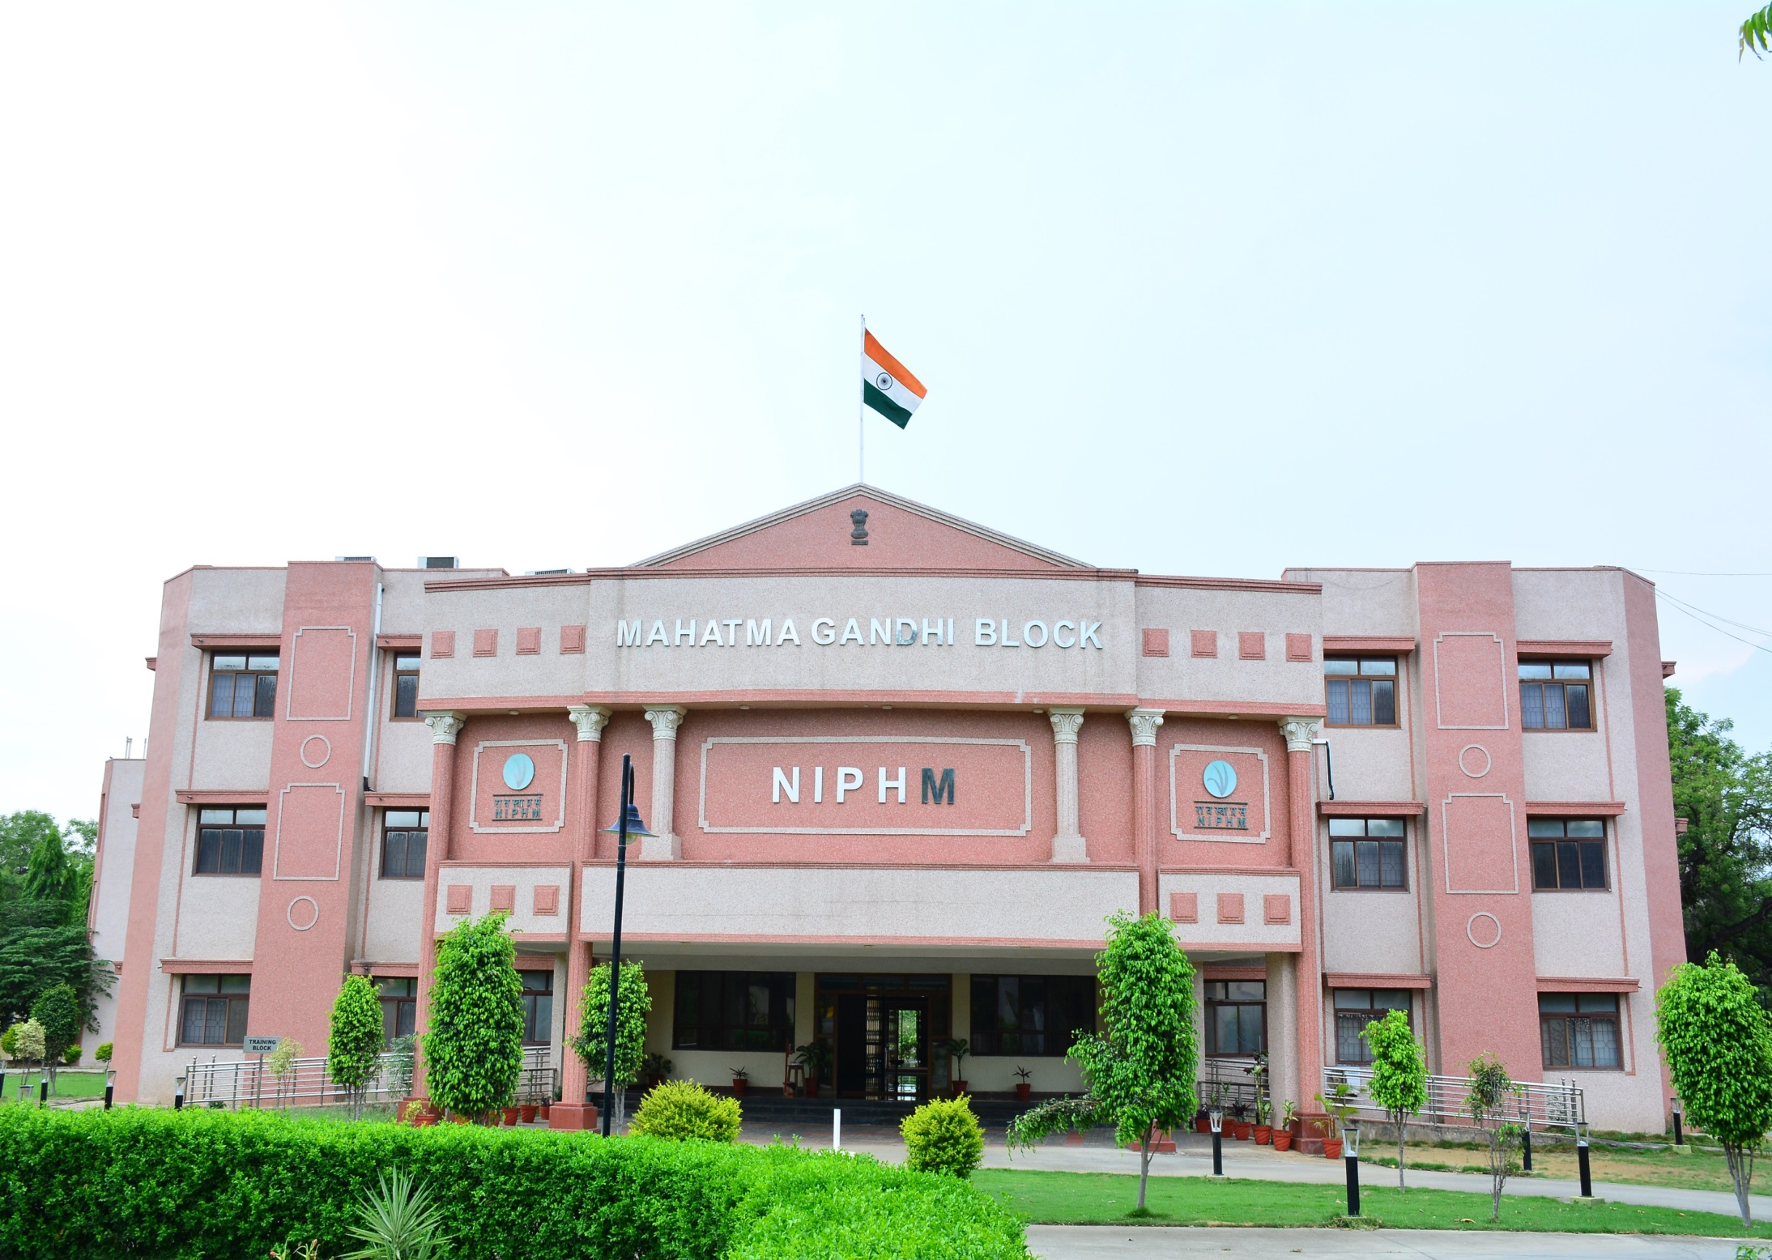
Agricultural Drone Training at NIPHM
Dr. Vidhu Kampurath P
Joint Director

Slide 2
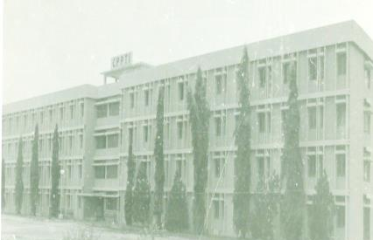
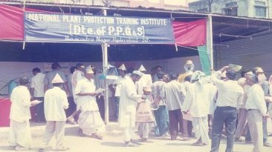
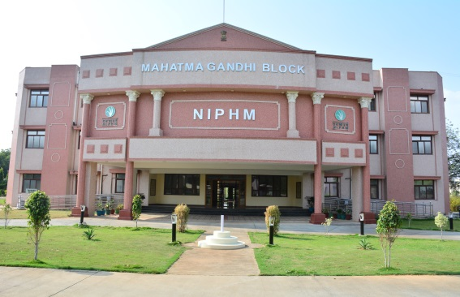
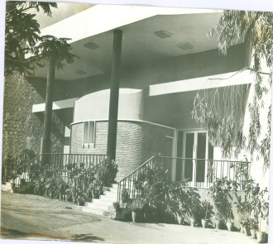
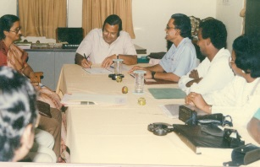
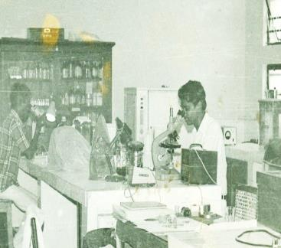
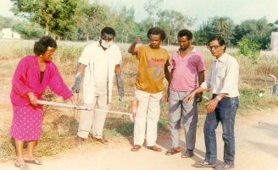
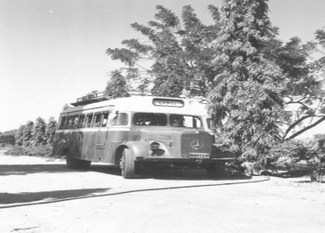
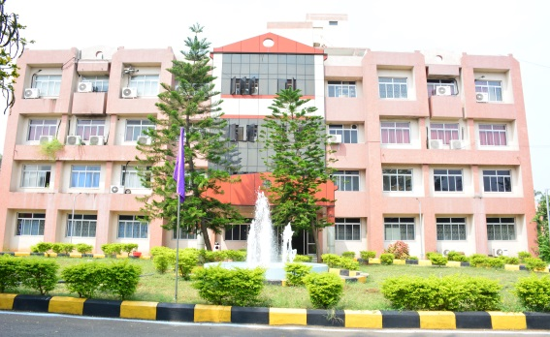
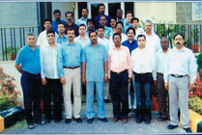
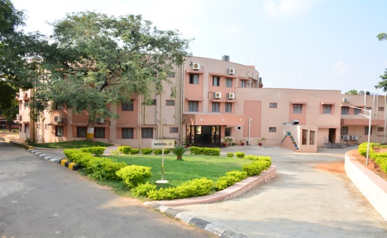
Journey of NIPHM
2008
NIPHM
1993
NPPTI
1966
CPPTI

Slide 3
Vision
Mission
To emerge as an internationally acclaimed Centre of Excellence in Biosecurity Management and promotion of environmentally sustainable Plant Health Management in diverse and changing agro-climatic conditions
To play a crucial role in enhancing agricultural production addressing the emerging challenges in the field of plant health management by assisting the Government of India, the States, and other stake holders through core role of teaching, training, research, certifications and accreditation, and policy support on SPS issues and Bio-Security challenges within National and International contexts

Slide 4
Major Divisions
Plant Health Management
Plant Biosecurity
Pesticide Management
Vertebrate & Urban Pest Management
Plant Health Engineering
Pest Surveillance and Pest Risk Analysis (PRA)
Plant Quarantine & Phyto sanitary treatments
Plant Quarantine & Phyto sanitary treatments
Plant Quarantine & Phyto sanitary treatments
Regional Plant Health System Analysis
Regional Plant Health System Analysis
Regional Plant Health System Analysis
Agro Ecosystem Analysis (AESA) and Ecological Engg.
Agro Ecosystem Analysis (AESA) and Ecological Engg.
Integrated Pest Management
Integrated Pest Management
Promotion of on-farm production technologies
Promotion of on-farm production technologies
Analysts & Inspectors training
Analysts & Inspectors training
Central Insecticide Lab for Bio-Pesticides
Central Insecticide Lab for Bio-Pesticides
Proficiency Testing (PT) Provider & Testing Labs
Integrated Rodent Pest Management
Pest Control Operators
Vertebrate Pest Management
Plant Protection Equipments
Good Spraying Practices
Farm Equipments
01-05-2022
4

Slide 5
Capacity Building Programs
Government Officials
Civil Society & Private Industry
Progressive Farmers
Students

Slide 6
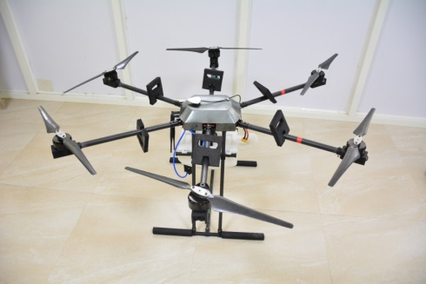
Agricultural Drones
NIPHM started its drone journey by initiating a research project of development of drones in 2018.
Successfully tested the drone in two crops and compared with traditional knapsack spraying.
Contributed to Standard Operating Procedures to be adopted in chemical spraying.
Developed a specific module for training the Sprayman in agricultural spraying.

Slide 7
Agricultural Drone Training
Participants drone pilots are only eligible for Module II training (chemical spraying) at NIPHM.
Thus mandates the training of candidates for the pilot license also.
Hence NIPHM has initiated to become an RPTO in association with M/s Marut Drones.
The regular pilot course is 5 day duration with approved DGCA syllabus.

Slide 8
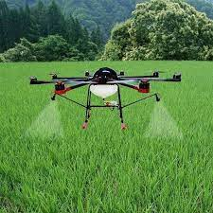
Module II training-Agro Chemical Spraying
Day 1
Basics of pesticide application
Introduction to Agri drone
Critical parameters in spraying

Slide 9
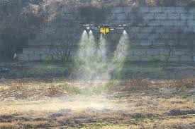
Module II training-Agro Chemical Spraying
Day 2
Nozzles and their use
Formulations and their management
Drone spraying
Critical parameters while applying-field study

Slide 10
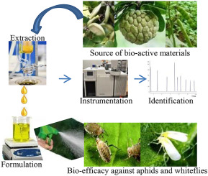
Module II training-Agro Chemical Spraying
Day 3
Residue and bio efficacy effects
Drift and non-target application
Requirements of Buffer zone
Calibration of spraying

Slide 11
Module II training-Agro Chemical Spraying
Day 4
Safe application standards
Use of PPE kits
Basic maintenance issues
Field practical on care and maintenance
Dos and Don’ts

Slide 12
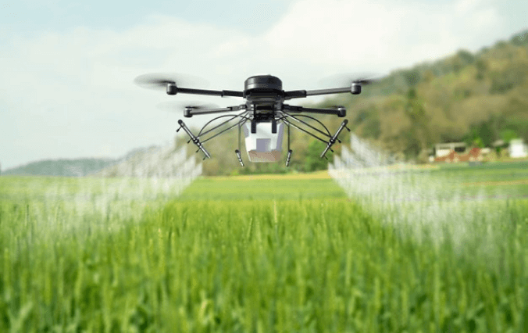
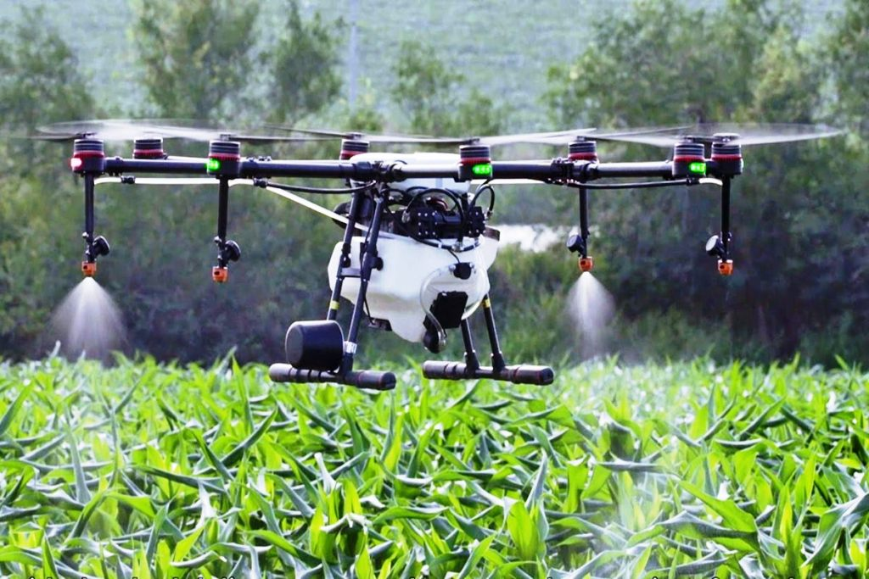
Module II training-Agro Chemical Spraying
Day 5
Practical field trials
Evaluation and assessment

Slide 13
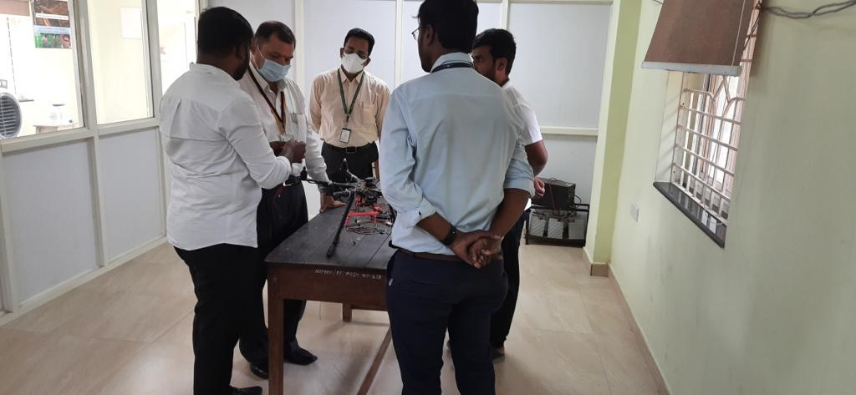
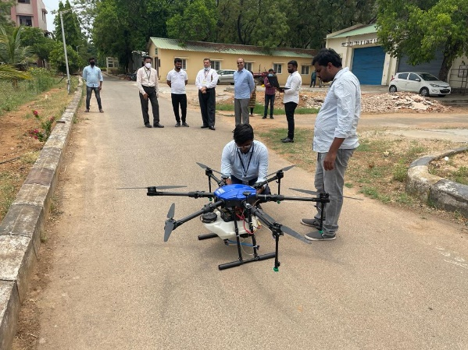
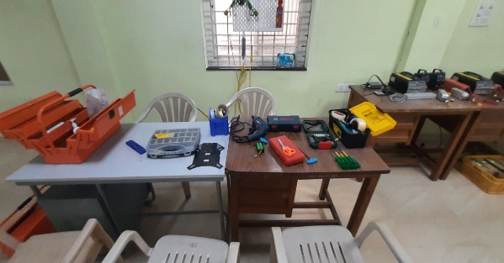
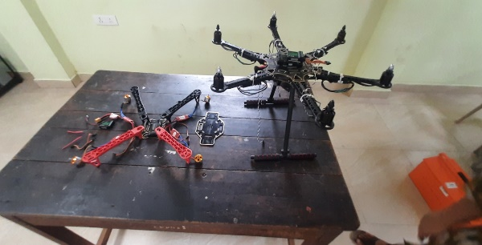
Preparedness of NIPHM in drone training
The NIPHM Drone Academy is being setup in association with M/s Marut Drones to train the pilots in drone flying.
Ready for starting the training in Module II of agro chemical spraying.
Prepared and submitted an online module for agro-chemical spraying.

Slide 14
Issues and challenges
Conducting the training online
Availability of certified drone pilots
Regularising the already practicing drone pilots
Bio efficacy issues
Mixing of chemicals
Owning drones and giving it as a service
Requirement of more training institutes (RPTO)
Collaborative approach in training and research

Slide 15
Thank you…

